Slide 1
Definitions
Eupnea = normal quite breathing at rest
( breathing rate of 12 – 20 breaths per minute )
Hyperventilate = increased ventilation that exceeds metabolic needs
Increased breathing rate ( ie , tachypnea ) and / or overly deep breaths
eg , during anxiety attack
Hypoventilate = decreased ventilation that is associated with abnormalities
Decreased respiratory rate ( ie , bradypnea ) and / or shallow breaths
eg , pulmonary diseases , hypoventilation syndrome

Slide 2
Respiratory System – Airways
Nares
Nasal Cavity
Pharynx
Larynx
Trachea
Bronchi
Bronchioles
Terminal Bronchioles
Respiratory Bronchioles
Alveolar Ducts
Alveoli
Conducting Zone
Respiratory Zone

Slide 3
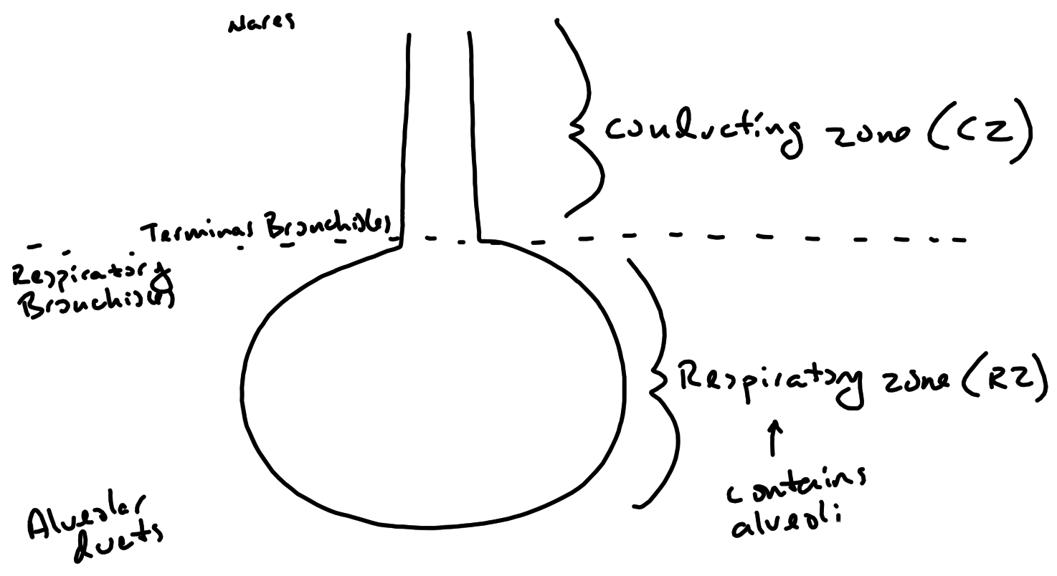

Slide 4
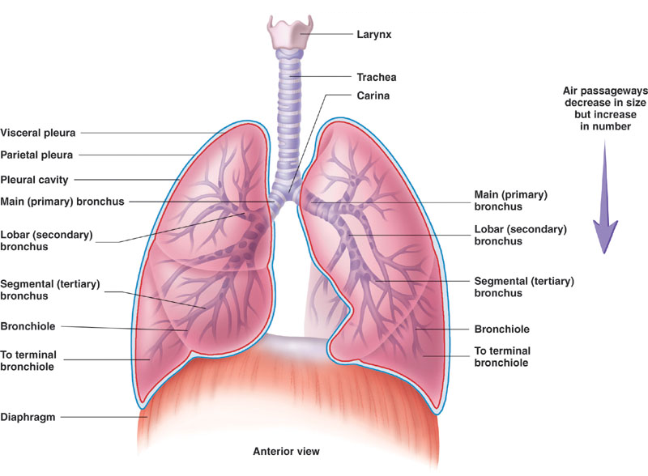
Respiratory System – Airways – Conducting Zone

Slide 5
Respiratory System – Airways – Conducting Zone
Functions :
Controls the volume of air into and out of the respiratory tract
Controlled by airway smooth muscle tone
eg , β-2 receptors
Relax airway smooth muscle
Bronchodilation
eg , Muscarinic receptors
Contract airway smooth muscle
Bronchoconstriction
Brings inhaled air to body temperature and fully humidifies it
Done by rich supply of blood vessels in mucous membrane

Slide 6
Respiratory System – Airways – Conducting Zone
Functions :
Filters and protects the respiratory tract from particulates
Nose hairs and mucus trap larger particles
Bronchoconstriction when polluted air is breathed
Mucociliary Escalator
Goblet cells produce mucus
Traps finer particles
Ciliated epithelial cells
Propel debris trapped in mucus to pharynx
Cilia slowed by cold , dry air
Cilia damaged by cigarette smoke
Mucus thickened in those with cystic fibrosis
Difficult for cilia to propel mucus

Slide 7
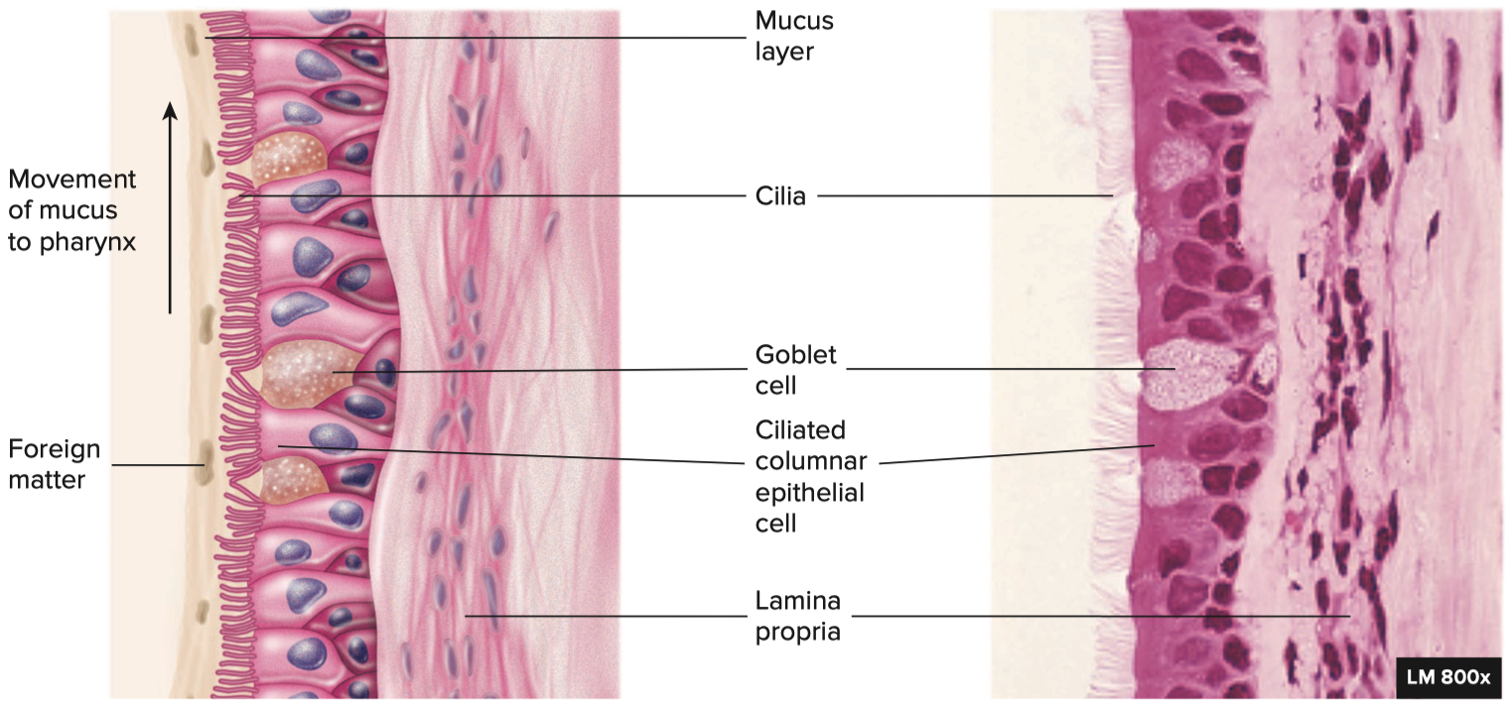
Respiratory System – Airways – Mucociliary Escalator

Slide 8
Respiratory System – Airways – Respiratory Zone
Respiratory bronchioles
Alveolar Ducts
Alveolar Sacs
Sole site of gas exchange ( there is no gas exchange in the conducting zone )
Occurs in the alveoli which are present solely in respiratory zone

Slide 9
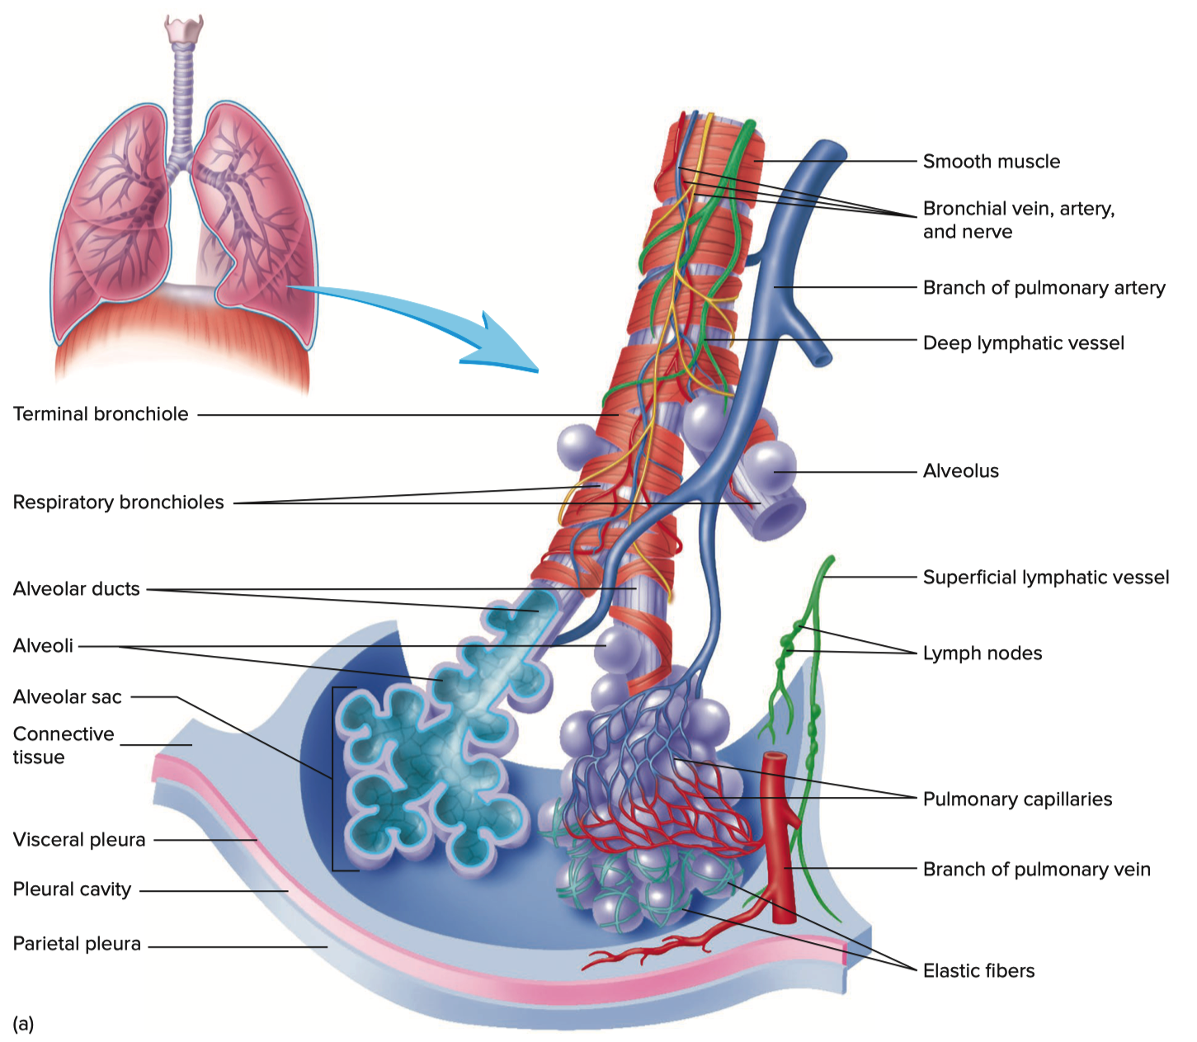
Respiratory System – Airways – Respiratory Zone

Slide 10
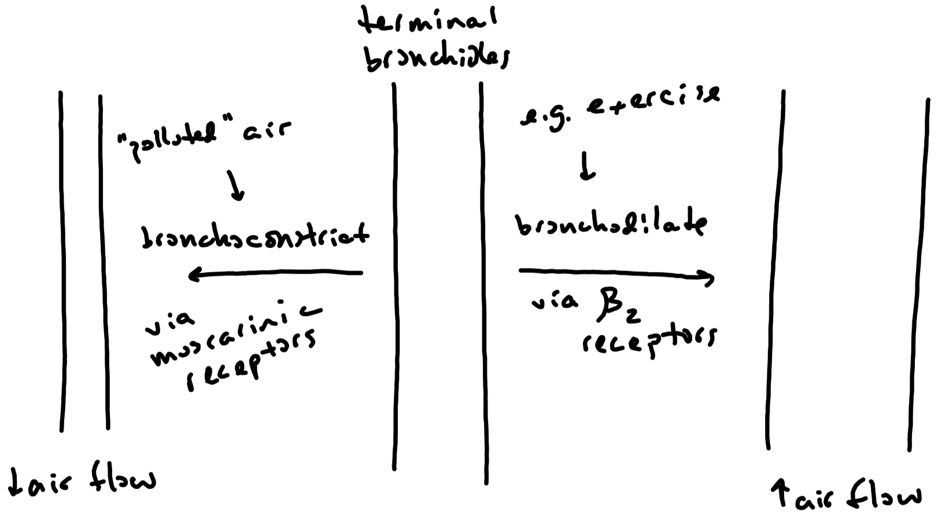

Slide 11
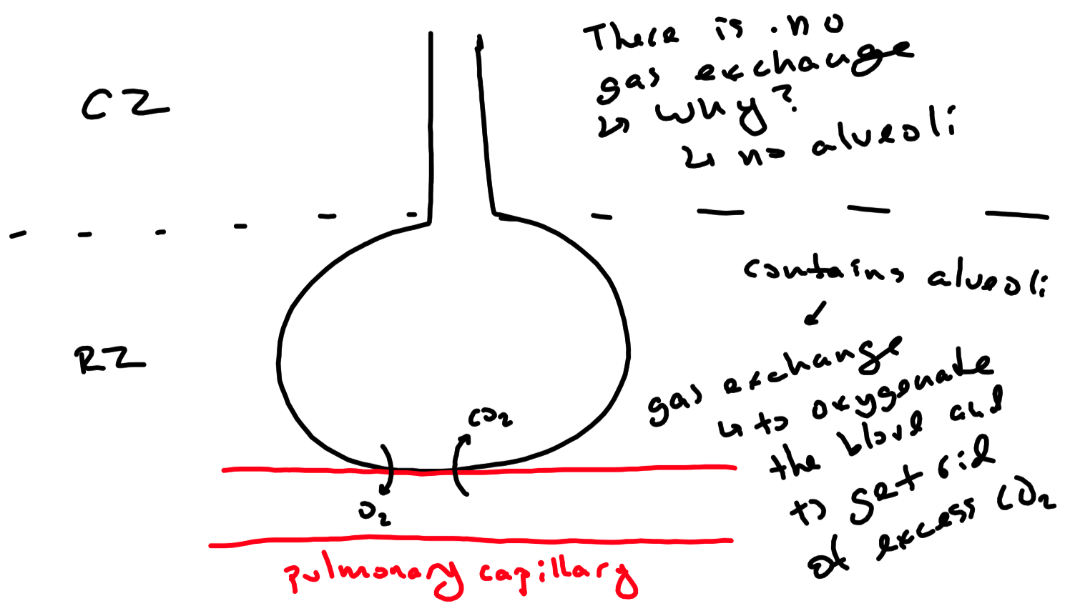

Slide 12
Respiratory System – Airways – Dead Space
No Gas Exchange
Anatomic Dead Space
Volume of the conducting zone
Averages approximately 150 mL ( varies with height )
Contains no alveoli
Therefore , there is no gas exchange
Alveolar Dead Space
Alveoli that are not perfused
Therefore , there is no gas exchange
Volume is ”zero” in healthy individuals
Physiological Dead Space
Combination of anatomic and alveolar dead spaces

Slide 13
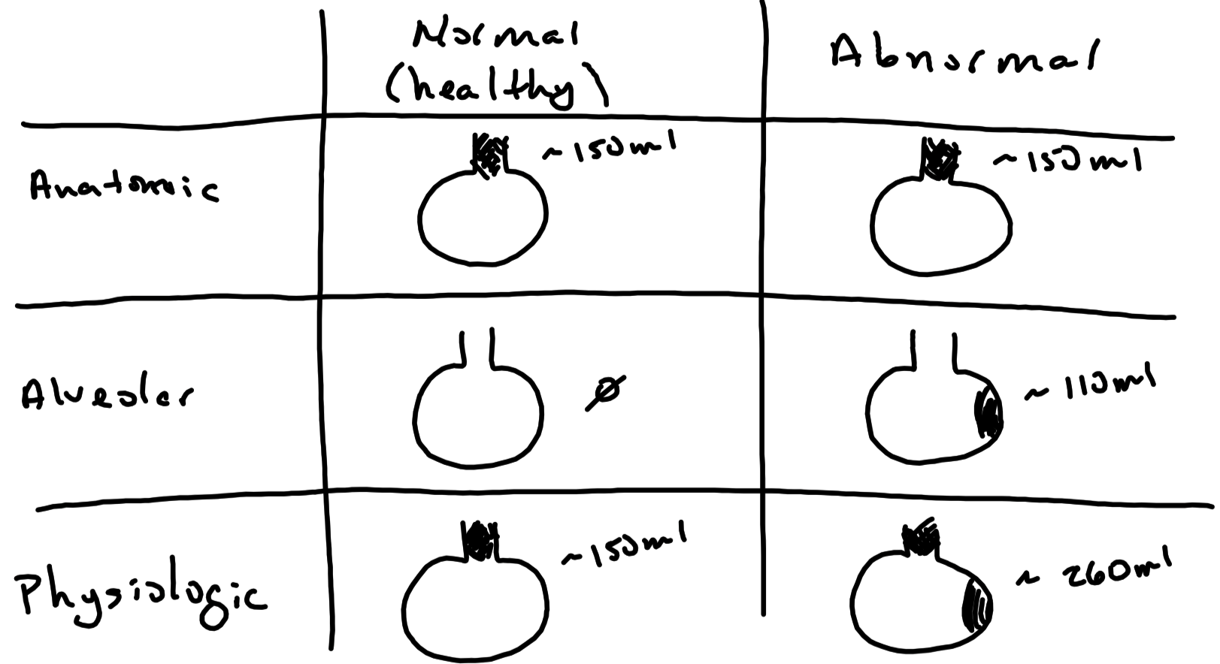

Slide 14
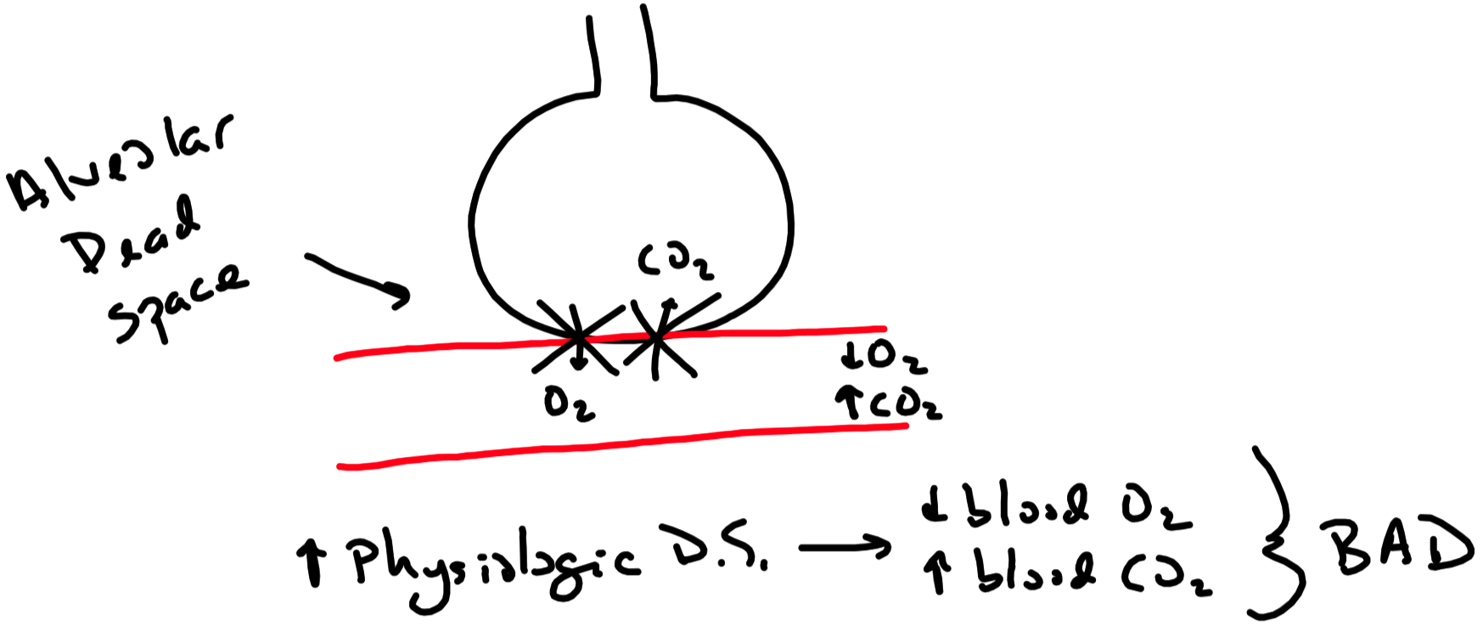

Slide 15
Respiratory System – Lungs
Elastic
Elastin fibers contained in the interstitium
Allows lungs to stretch and recoil
Pleura
Visceral Pleura
Covers the lungs
Parietal Pleura
Lines thoracic cavity and is attached to the diaphragm
Pleural Space
Fluid-filled potential space between the pleural layers
Pressure in the space is less than pressure in the alveoli
Allows lung to remain inflated
Structure of pleura allows lungs to move along with thorax

Slide 16
Respiratory System – Lungs
Compliance
Measure of the ease with which a structure expands when exposed to pressure
In other words : measure of the stretchiness / stiffness of a structure

Slide 17
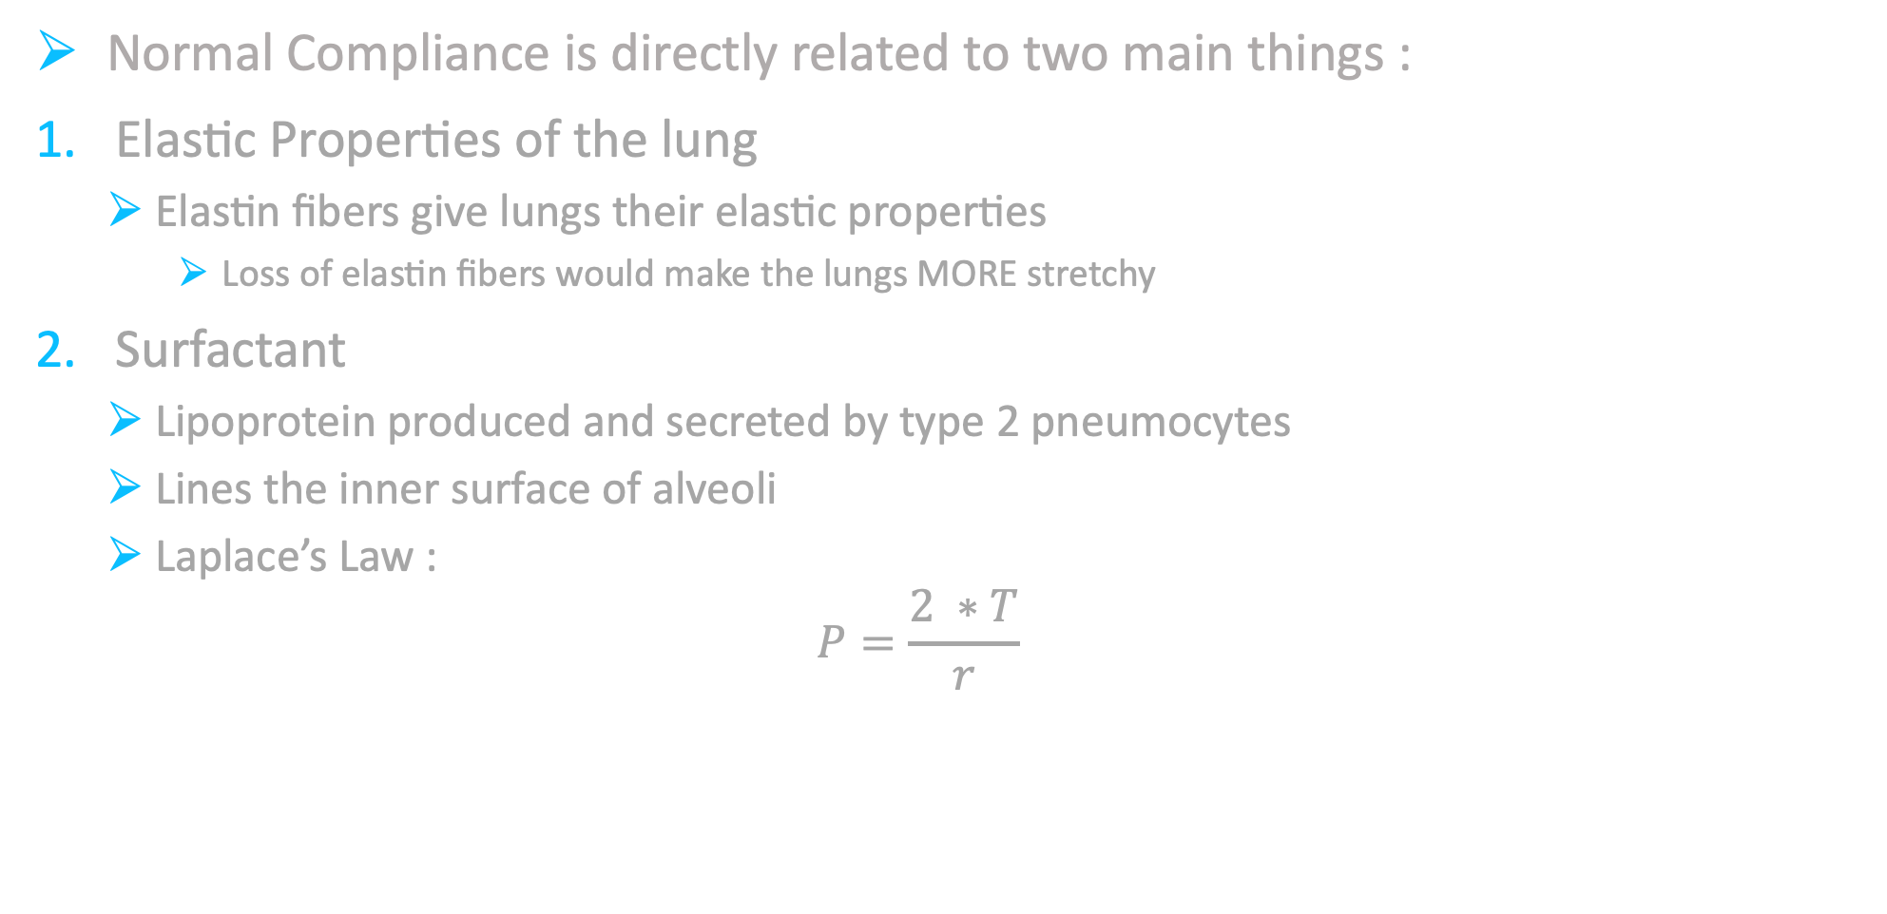
Respiratory System – Lungs
Normal Compliance is directly related to two main things :
Elastic Properties of the lung
Elastin fibers give lungs their elastic properties
Loss of elastin fibers would make the lungs MORE stretchy
Surfactant
Lipoprotein produced and secreted by type 2 pneumocytes
Lines the inner surface of alveoli
Laplace’s Law :
$$P=\frac{2 ∗T}{r}$$
P = Pressure T = Surface Tension r = radius ( of alveoli )
P : pressure needed to keep alveoli from collapse
T : force that favors collapse of alveoli
Surfactant reduces surface tension
Reduces the pressure needed to keep alveoli from collapsing
Helps prevent alveoli from collapse

Slide 18
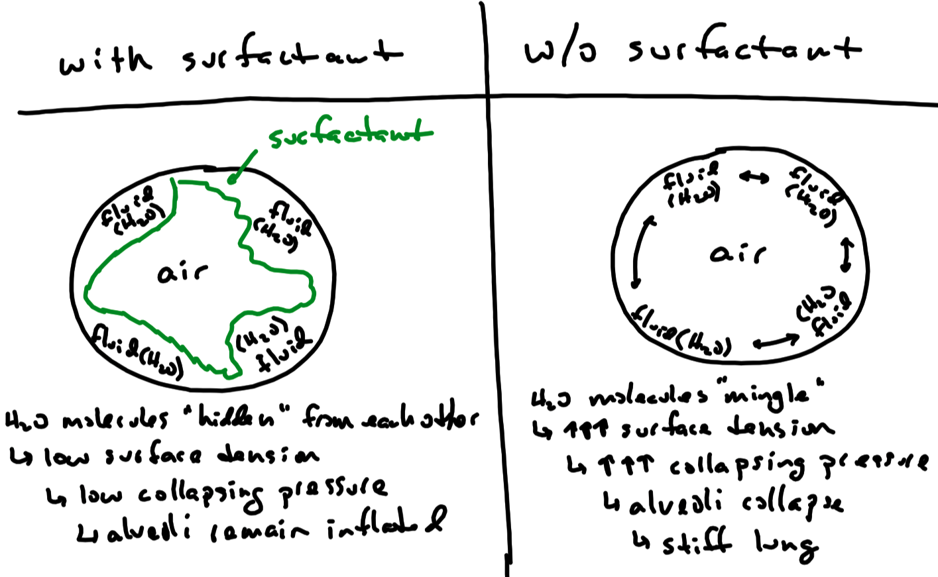

Slide 19
Respiratory System – Lungs
An increase in compliance indicates the lung is too “stretch”
Caused by damage / loss of elastin fibers
eg , emphysema where there is destruction of elastin fibers
A decrease in compliance indicates the lung is too “stiff”
eg , interstitial lung disease where interstitium becomes fibrous
eg , surfactant deficiency disorder where there is a lack of surfactant
Alveoli without surfactant causes surface tension to be high
Pressure to keep alveoli from collapsing is now high
Alveoli vulnerable to collapse ( atelectasis )
When alveoli are collapsed the lung becomes very stiff

Slide 20
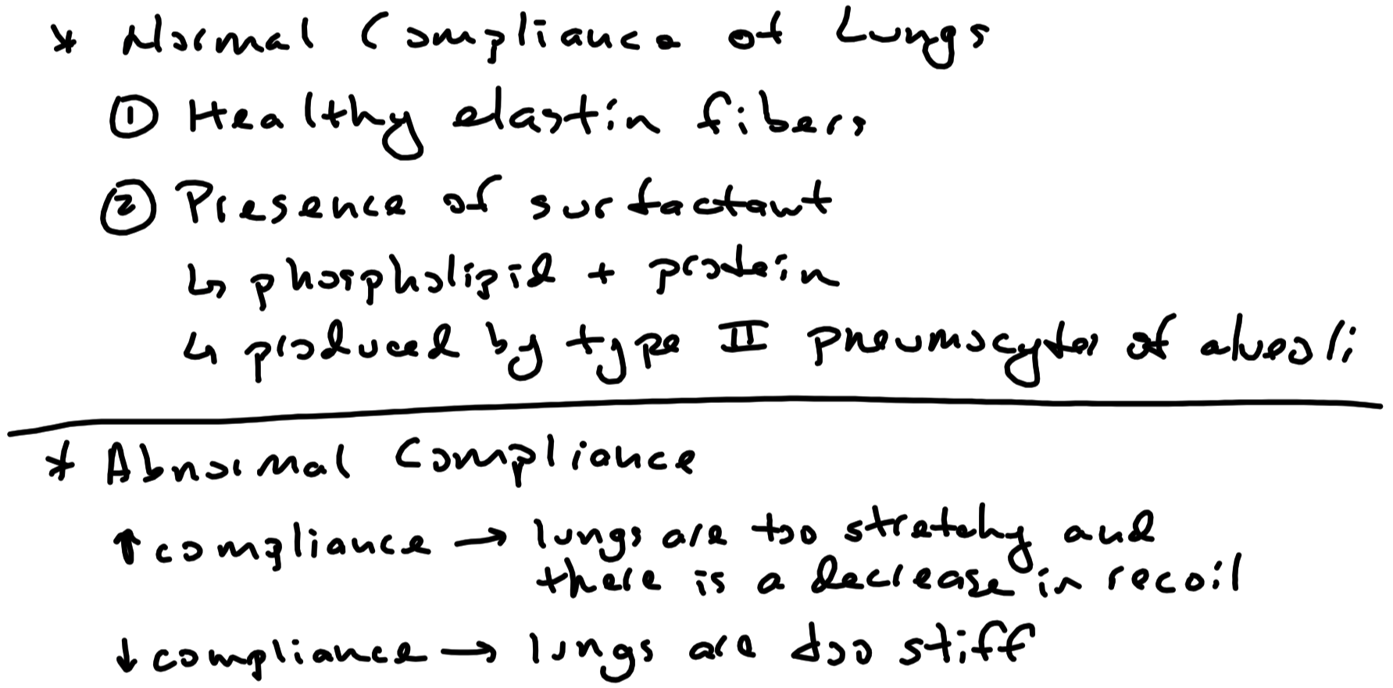

Slide 21
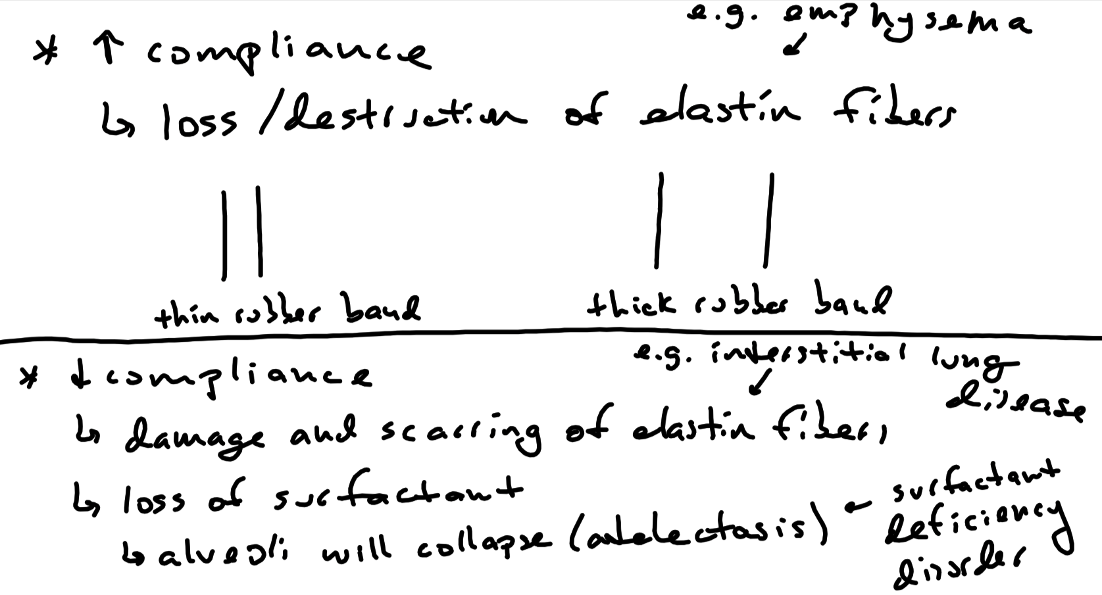

Slide 22
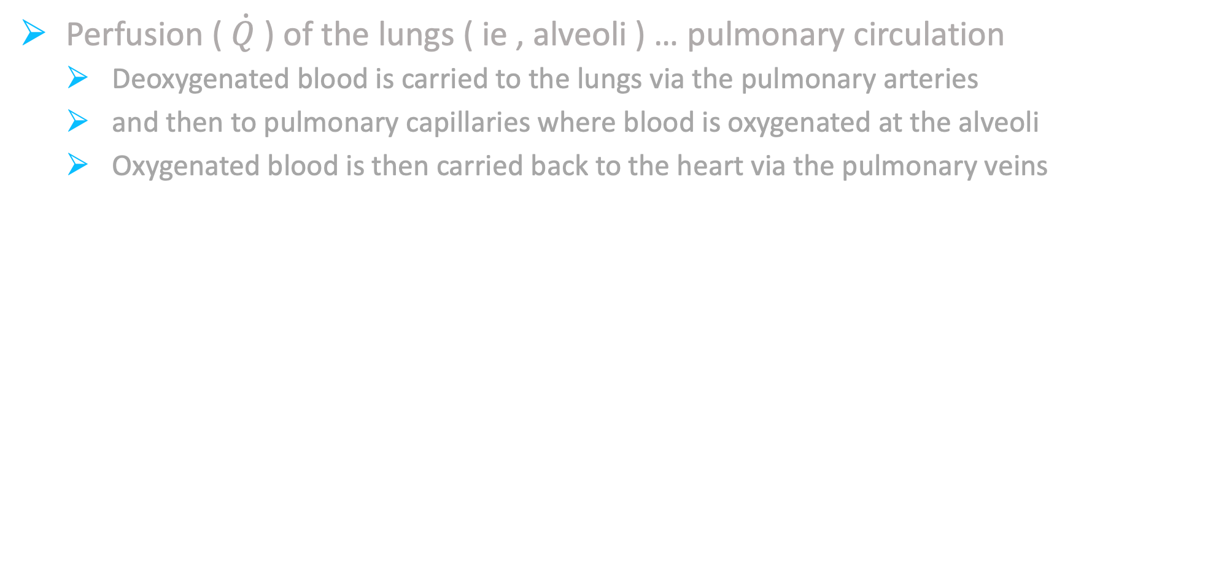
Respiratory System – Circulation
Perfusion ( $\dot{Q}$ ) of the lungs ( ie , alveoli ) … pulmonary circulation
Deoxygenated blood is carried to the lungs via the pulmonary arteries
and then to pulmonary capillaries where blood is oxygenated at the alveoli
Oxygenated blood is then carried back to the heart via the pulmonary veins

Slide 23
Respiratory System – Perfusion ( $\dot{Q}$ ) of the Lungs
Right Ventricle
Pulmonary Arteries
Pulmonary Capillaries
Pulmonary Veins
Left Atrium
perfusion
of alveoli

Slide 24
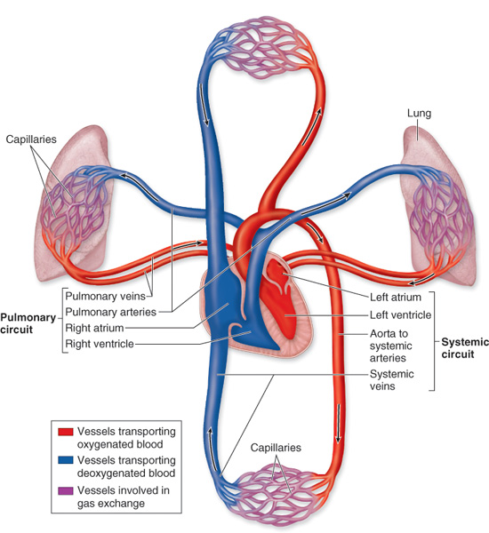
Respiratory System – Perfusion ( $\dot{Q}$ ) of the Lungs

Slide 25
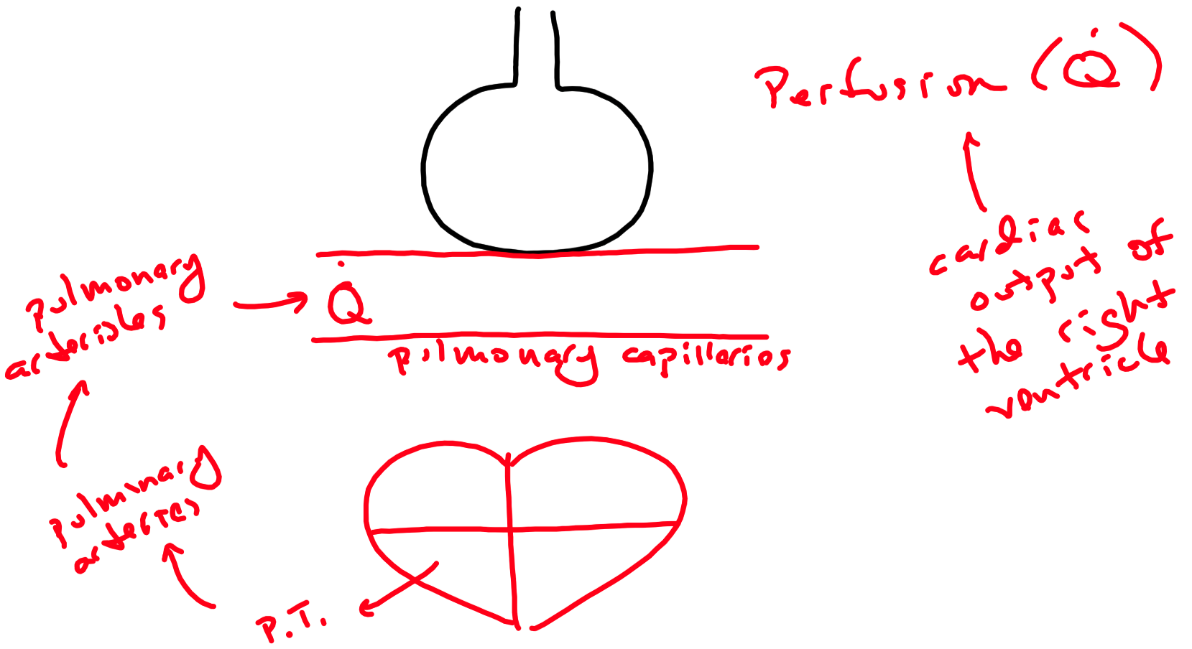

Slide 26
Respiratory System – Bronchial Circulation
Left Atrium
Left Ventricle
Aorta
Bronchial Arteries
Systemic Capillaries
Bronchial Veins
Oxygenated blood is carried to lung tissue via the bronchial arteries
Deoxygenated blood is returned to the right atrium via the bronchial veins
lung tissue
Right Atrium

Slide 27

Spirometry
Measurement of Lung Volumes and Lung Capacities

Slide 28
Spirometry
Measurement of lung volumes and capacities with the use of a spirometer
Lung Volumes
( average values are for average size adult male … ~10% less for female )
Tidal Volume ( V_{T} ) = approximately 500 mL
Volume of air inspired or expired during normal , quiet breathing
Inspiratory Reserve Volume ( IRV ) = approximately 3,000 to 3,300 mL
Maximum amount of air that can be inspired at end of a normal inspiration
Expiratory Reserve Volume ( ERV ) = approximately 1,000 to 1,200 mL
Maximum amount of air that can be expired at end of a normal expiration
Residual Volume ( RV ) = cannot be measured with a spirometer ( ~ 1,200 mL )
Volume of air remaining in the lungs after a forced expiration
Residual volume cannot be measured by normal spirometry
Lung Capacities
( average values are for average size adult male … ~10% less for female )
Inspiratory Capacity ( IC ) = approximately 3,500 to 3,800 mL
Volume of air that can be inspired after a normal expiration
IC = VT + IRV
Vital Capacity ( VC ) = approximately 4,500 to 5,000 mL
Volume of air expired from lungs after a maximal inspiration
VC = VT + IRV + ERF
Functional Residual Capacity ( FRC ) = approximately 2,200 to 2,400 mL
Volume of air remaining in the lungs after a normal expiration
FRC = ERV + RV
Total Lung Capacity ( TLC ) = approximately 5,700 to 6,200 mL
Volume of air in the lungs after a maximal inspiration
TLC = VT + IRV + ERV + RV

Slide 29
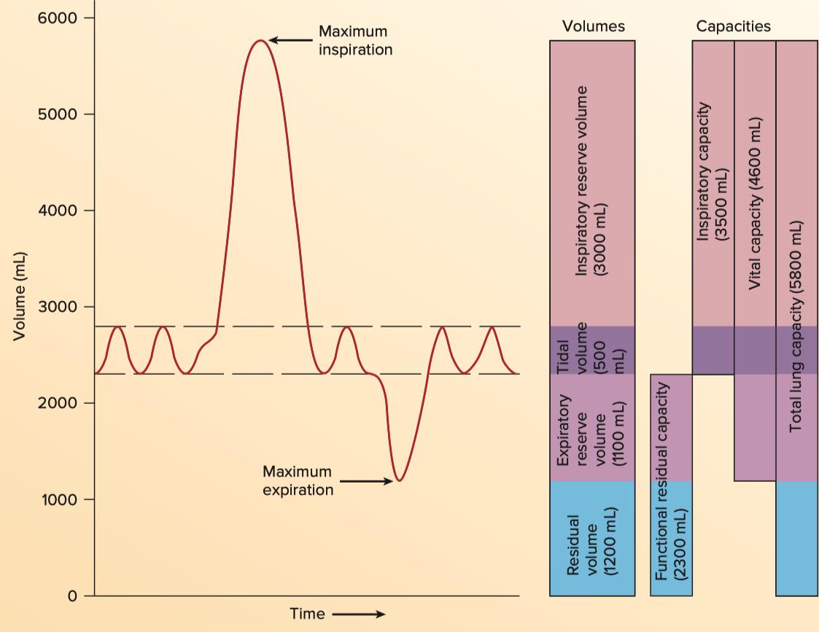
Lung Volumes and Capacities

Slide 30
Lung Volumes and Capacities
IRV
IC
VC
TLC
V_{T}
ERV
FRC
RV
RV

Slide 31
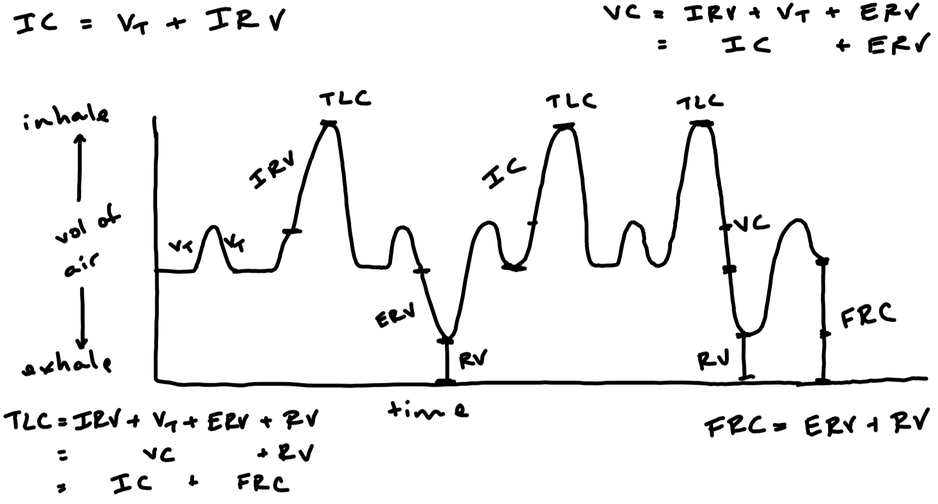

Slide 32
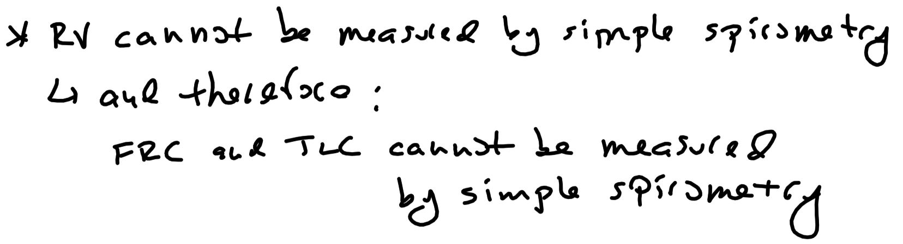

Slide 33
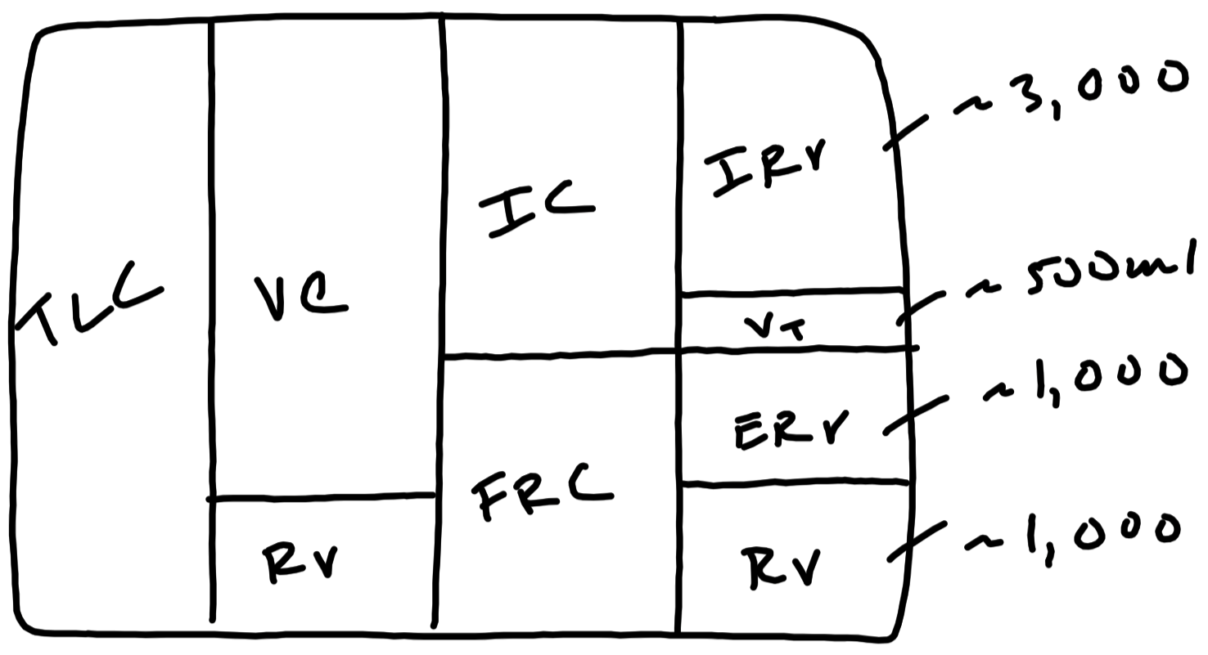

Slide 34
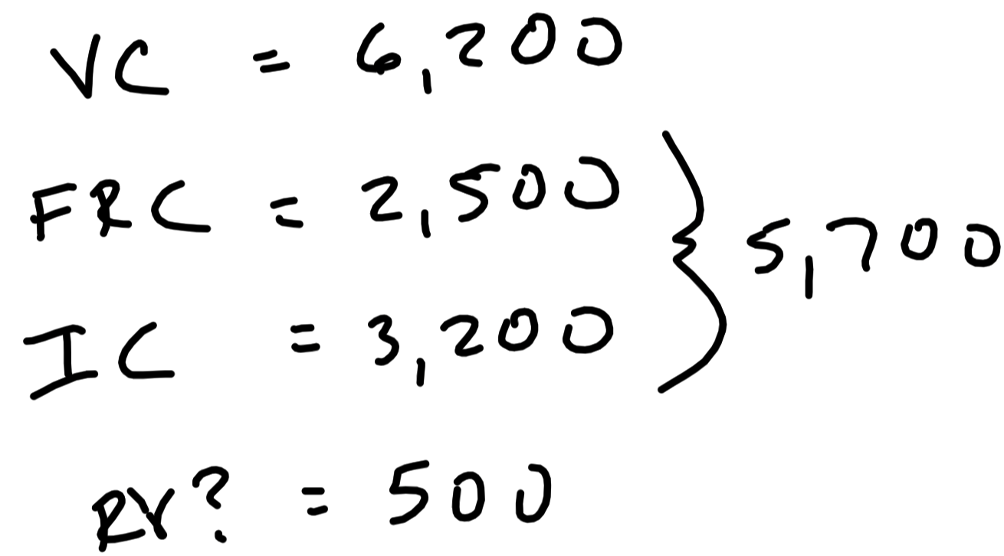

Slide 35
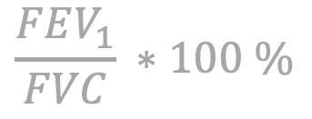
Forced Vital Capacity ( FVC ) Maneuver ( assesses the health of the respiratory system )
FVC :
Volume of air forcefully expired after a maximal inspiration
Normal FVC ≈ 5,00 mL
FEV₁
Volume of air forcefully expired during the first second
Normal FEV₁ ≈ 3,500 to 4,000 mL
Normal FEV₁ / FVC ≈ 70 to 80%
Therefore , under normal conditions , 70 to 80% of air is forcefully expired from the lungs in the first second
$$\frac{FEV_{1}}{FVC} ∗100 \%$$

Slide 36
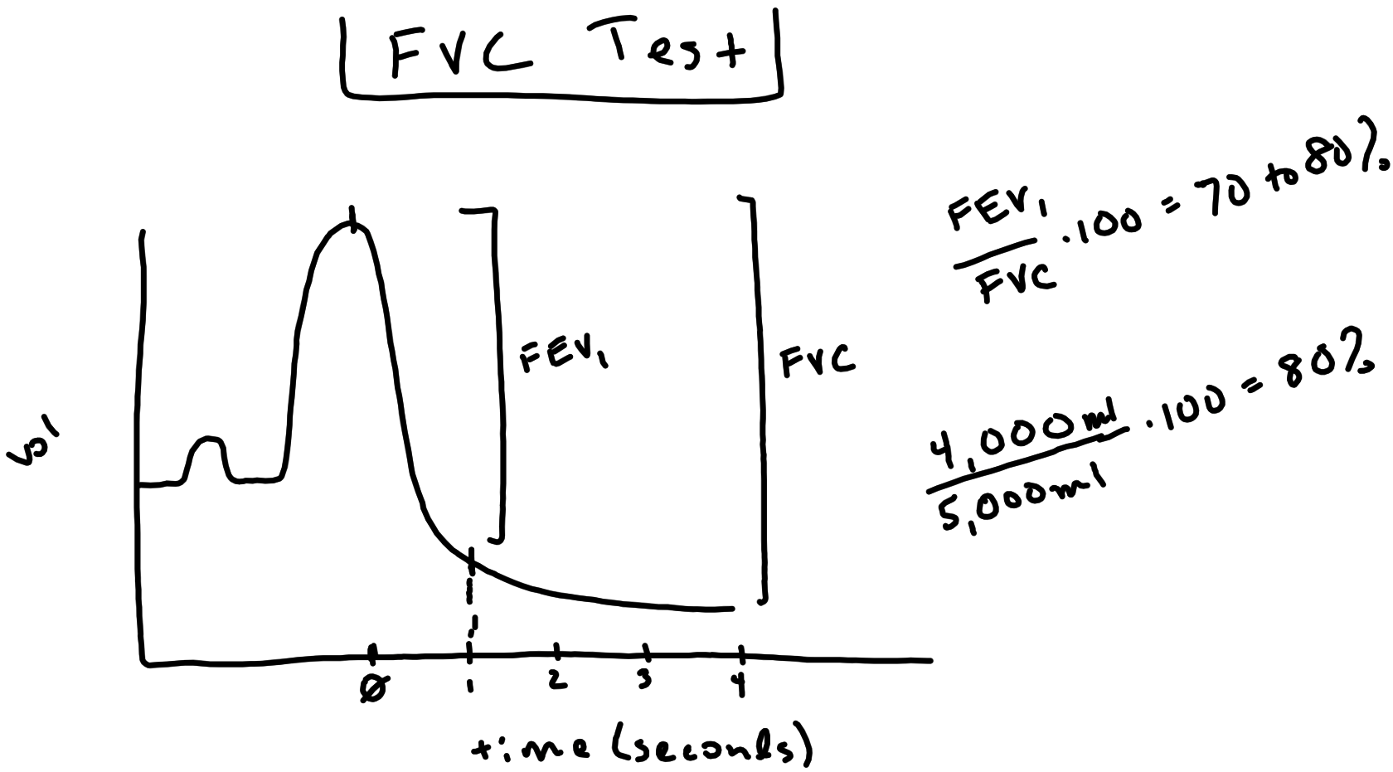

Slide 37
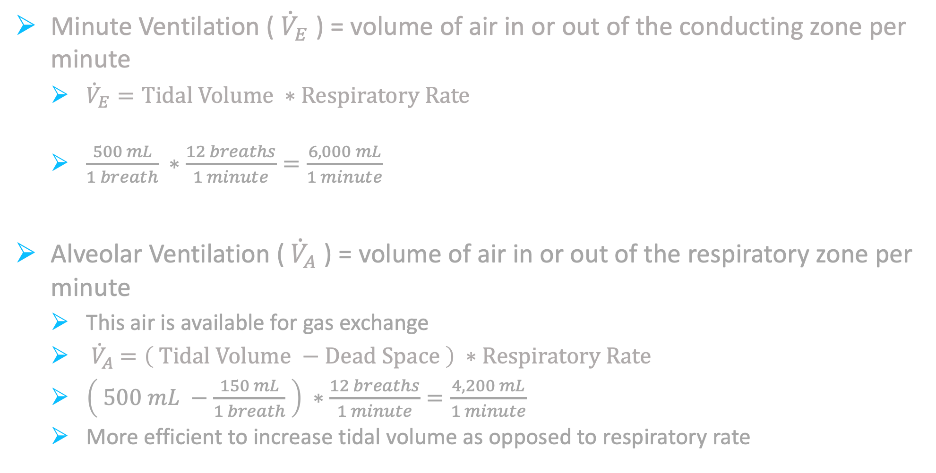
Pulmonary Ventilation
Minute Ventilation ( ${\dot{V}}_{E}$ ) = volume of air in or out of the conducting zone per minute
${\dot{V}}_{E}=Tidal Volume ∗Respiratory Rate$
$\frac{500 mL}{1 breath} ∗\frac{12 breaths}{1 minute}=\frac{6,000 mL}{1 minute}$
Alveolar Ventilation (${ \dot{V}}_{A}$ ) = volume of air in or out of the respiratory zone per minute
This air is available for gas exchange
${ \dot{V}}_{A} =\left( Tidal Volume −Dead Space \right) ∗Respiratory Rate$
$\left( 500 mL −\frac{150 mL}{1 breath} \right) ∗\frac{12 breaths}{1 minute}=\frac{4,200 mL}{1 minute}$
More efficient to increase tidal volume as opposed to respiratory rate

Slide 38
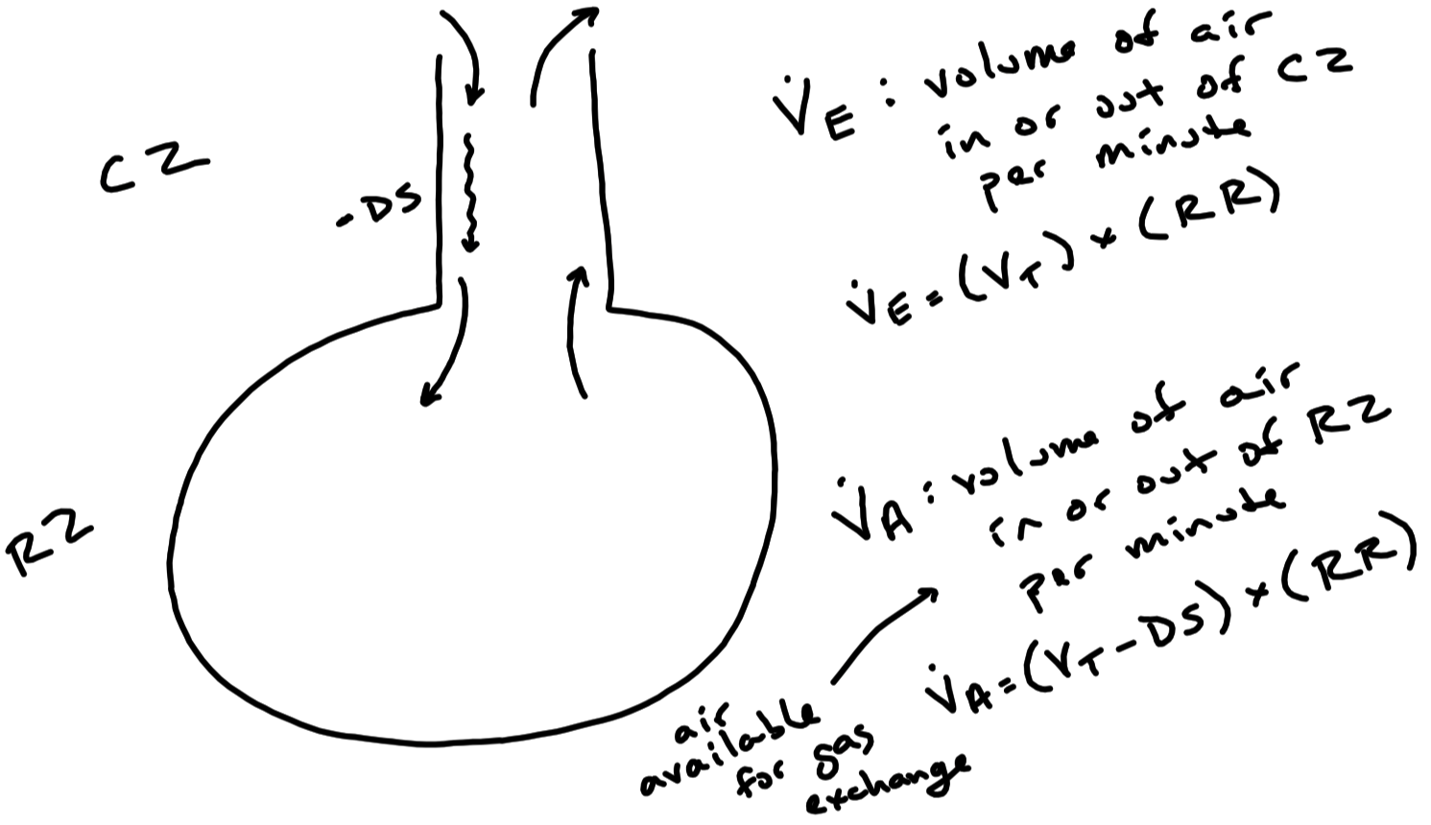

Slide 39
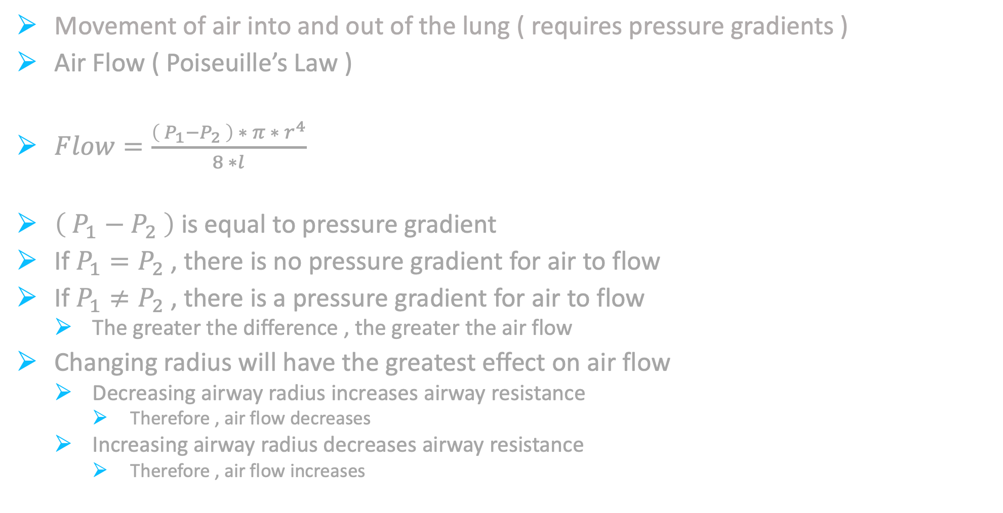
Breathing
Movement of air into and out of the lung ( requires pressure gradients )
Air Flow ( Poiseuille’s Law )
$Flow=\frac{\left({ P}_{1}−P_{2} \right) ∗ π ∗{ r}^{4}}{8 ∗l}$
$\left( P_{1}−P_{2} \right)$ is equal to pressure gradient
If $P_{1}=P_{2}$ , there is no pressure gradient for air to flow
If $P_{1}≠P_{2}$ , there is a pressure gradient for air to flow
The greater the difference , the greater the air flow
Changing radius will have the greatest effect on air flow
Decreasing airway radius increases airway resistance
Therefore , air flow decreases
Increasing airway radius decreases airway resistance
Therefore , air flow increases
P₁ = pressure at point 1 ( inside the lung ) P₂ = pressure at point 2 ( outside the lung )
r = radius of airway

Slide 40
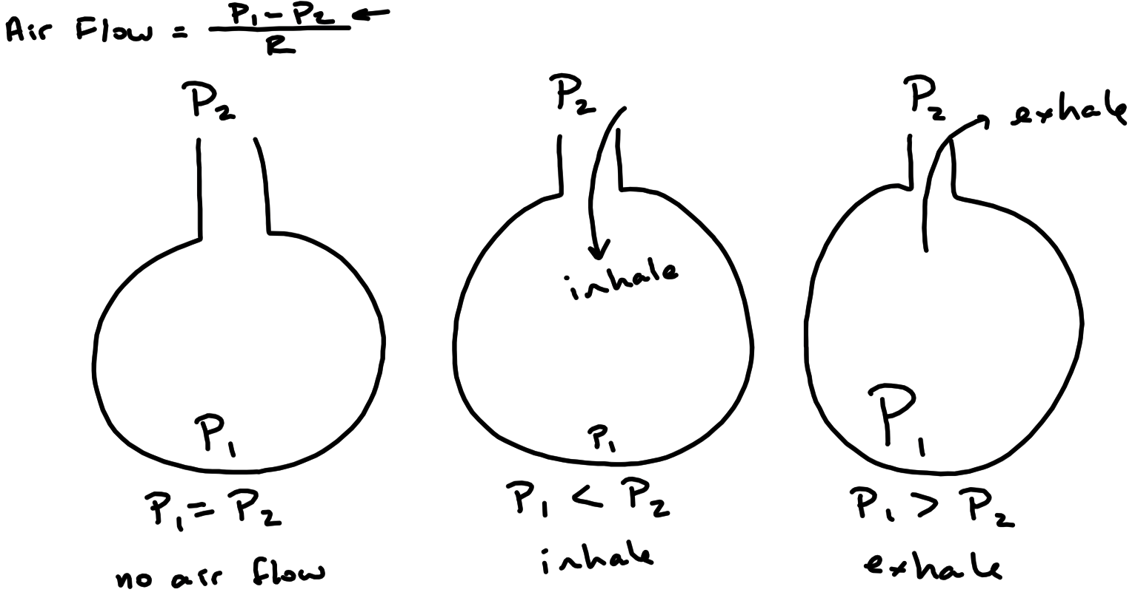

Slide 41
Air Flow , Pressure , and Resistance
P₂
P₂
P₂
P₂
P₂
P₁
P₁
P₁
P₁
P₁
P₁ = P₂
P₁ < P₂
P₁ > P₂
P₁ > P₂
↑r
P₁ > P₂
↓r

Slide 42
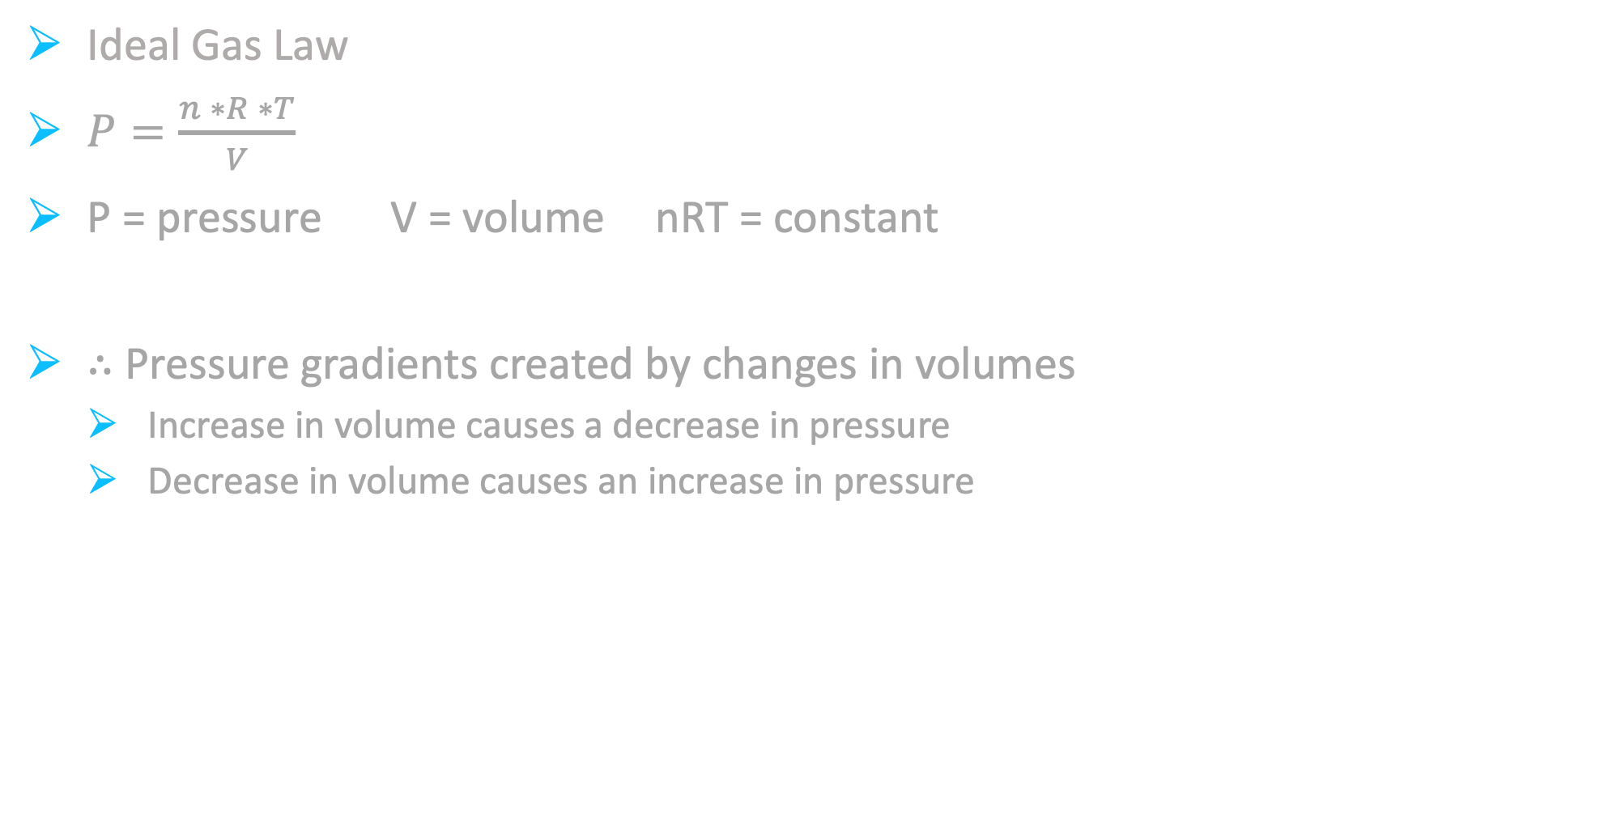
Breathing
Ideal Gas Law
$P=\frac{n ∗R ∗T}{V}$
P = pressure V = volume nRT = constant
$∴$ Pressure gradients created by changes in volumes
Increase in volume causes a decrease in pressure
Decrease in volume causes an increase in pressure

Slide 43
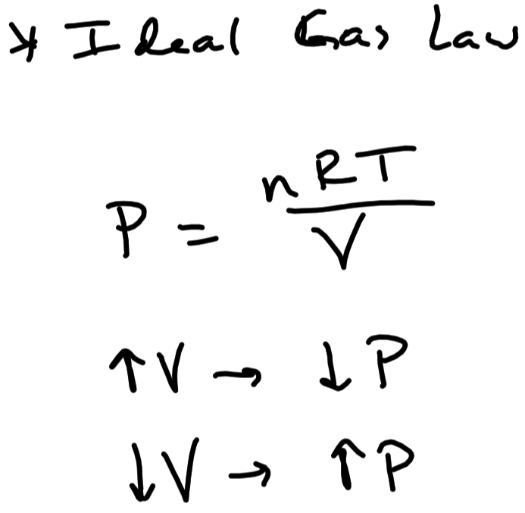

Slide 44
Breathing
Pressures involved in breathing :
Barometric Air Pressure ( P_{B} )
Atmospheric air pressure outside the body ( regardless of proximity )
Alveolar Pressure ( P_{alv} )
Pressure inside of an alveolus
Pleural Pressure ( P_{pl} )
Pressure in the pleural cavity ( ie , pressure outside of an alveolus )
Always less than P_{alv} ( ensures lungs do not collapse )
Due to recoil of lung and recoil of thorax

Slide 45
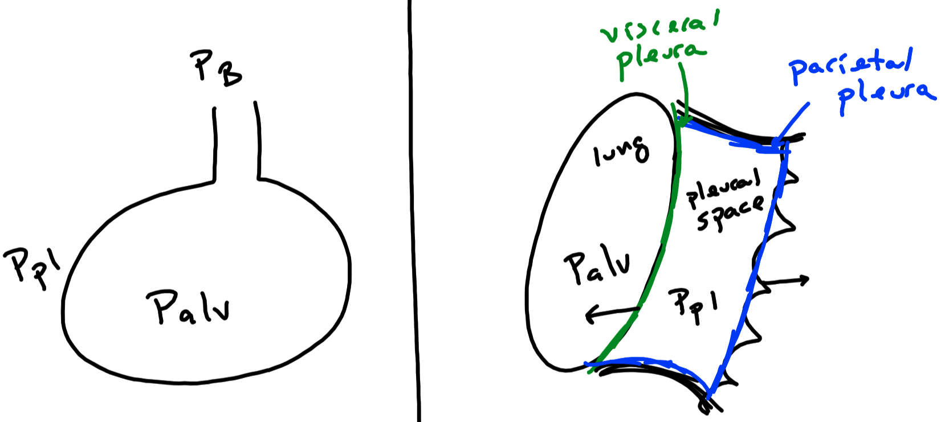

Slide 46
Breathing Cycle
End of Expiration
P_{B} and P_{alv} are both equal
( ie , ~ 1,000 cm H₂O )
No pressure gradient
No air flow
P_{pl} is less than P_{alv}
P_{pl} is 5 cm H₂O less than P_{alv} ( ie , 995 cm H₂O )
During Inspiration
Contraction of respiratory muscles
Increases thoracic cavity volume , which then increases pleural space volume
P_{pl} decreases towards 992 cm H₂O causing alveoli to inflate
Increases alveolar volume
P_{alv} decreases towards 999 cm H₂O
P_{alv} is less than PB now
Air into lung down pressure gradient
Air filling the alveoli causes P_{alv} to increase back towards 1,000 cm H₂O
End of Inspiration
Thoracic cavity has stopped expanding ( thoracic cavity at its greatest volume )
P_{pl} is 992 cm H₂O ( lowest level during breathing )
Alveoli have stopped inflating ( alveoli at their greatest volume )
Air into lungs during inspiration has filled the larger alveoli
P_{alv} is 1,000 cm H₂O
P_{alv} now equal to P_{B}
No air flow
During Expiration
Relaxation of respiratory muscles
Decreases thoracic cavity volume , which then decreases pleural space volume
P_{pl} increases toward 995 cm H₂O
Decreases alveolar volume toward resting levels
P_{alv} increases above P_{B} towards 1,001 cm H₂O
P_{alv} is greater than P_{B} now
Air out of lung down pressure gradient
Air leaving the alveoli causes P_{alv} to decrease back towards to 1,000 cm H₂O

Slide 47
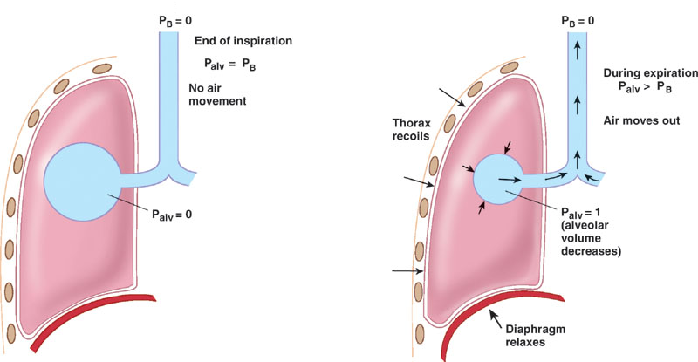
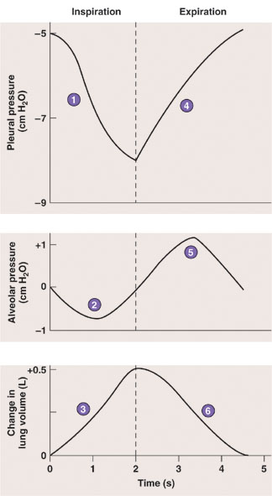
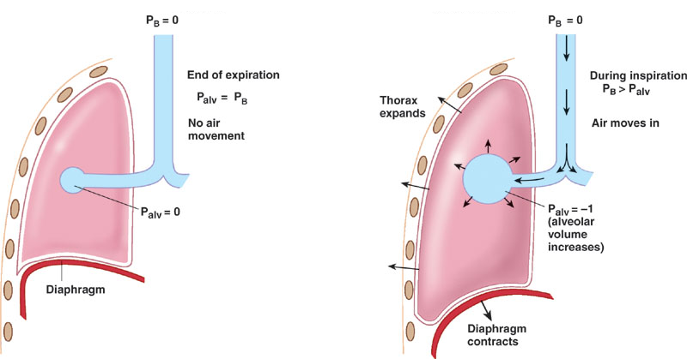

Slide 48
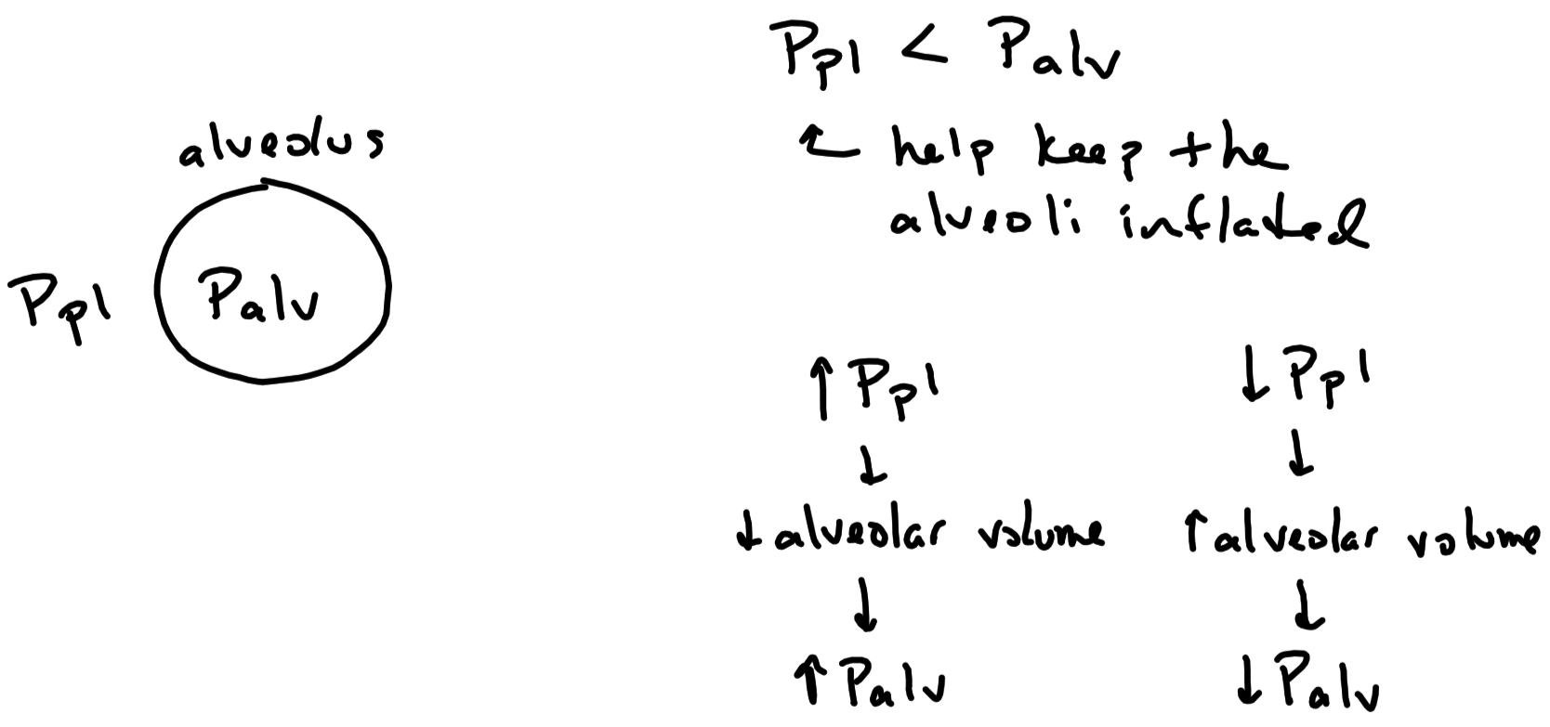

Slide 49
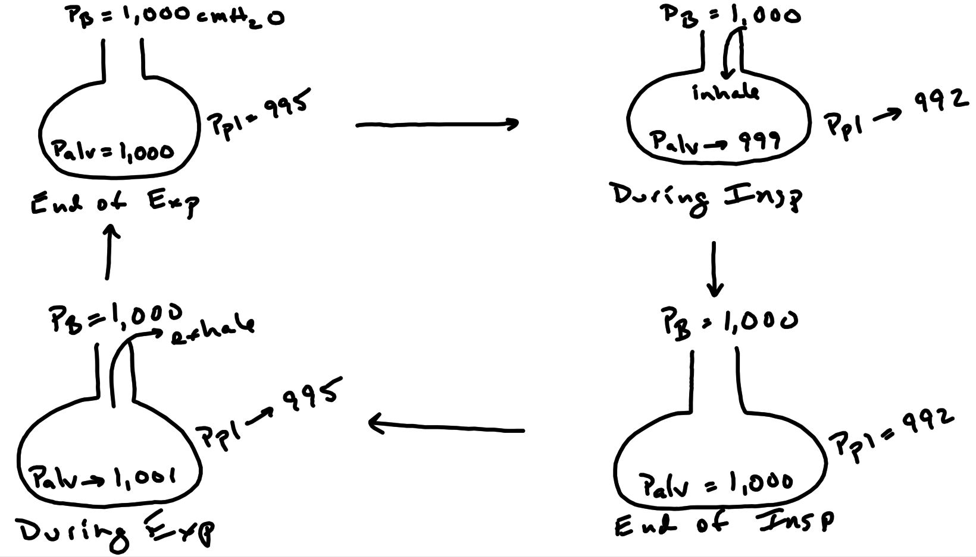

Slide 50
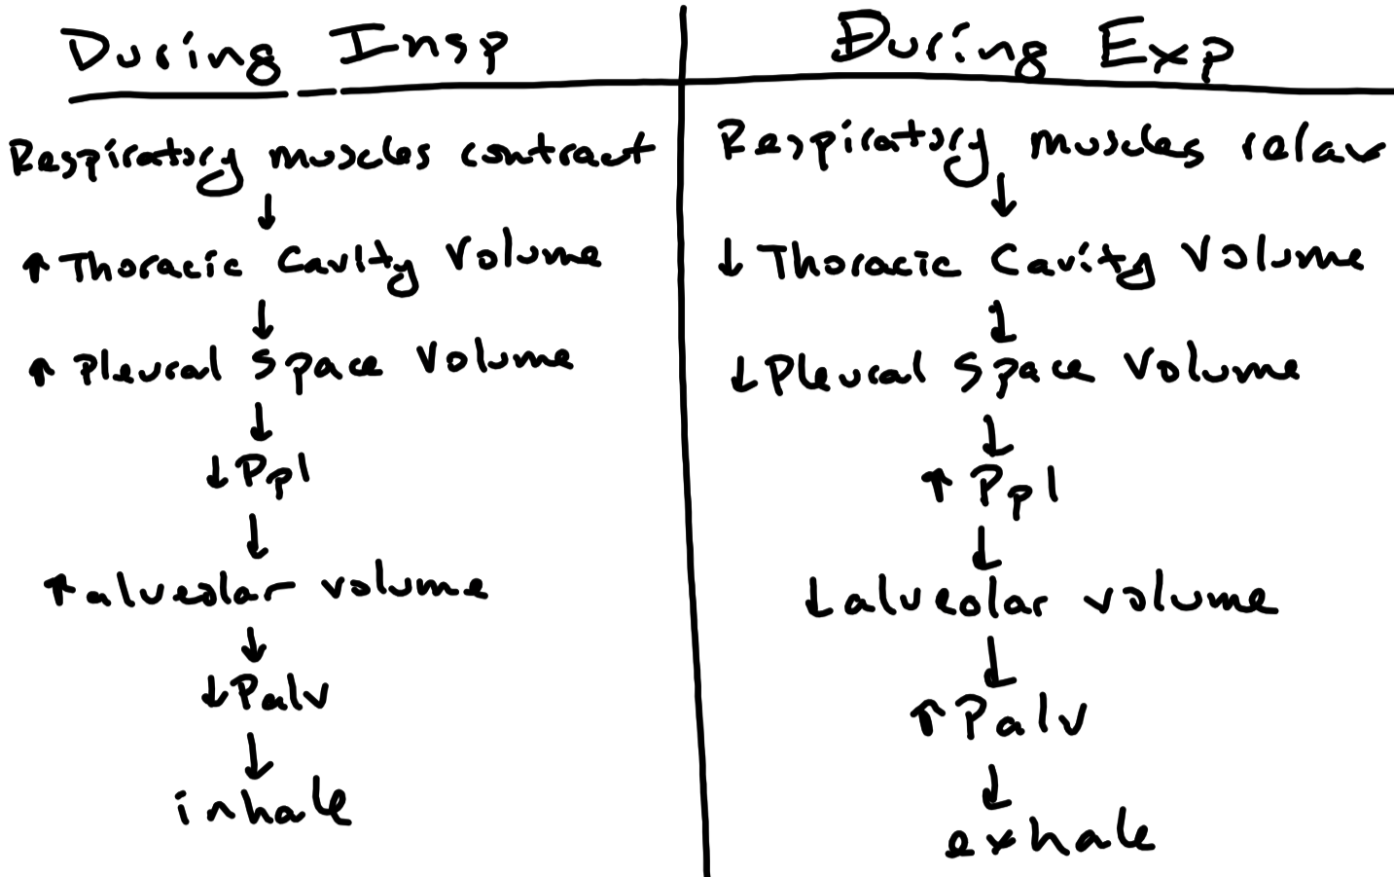

Slide 51
Pneumothorax
Presence of excess air in the pleural space leading to an increase in P_{pl}
P_{pl} is no longer less than P_{alv}
Causes the lung to collapse
Simple pneumothorax
P_{pl} and P_{alv} are equal
Surface tension will force alveoli to collapse
Tension pneumothorax
P_{pl} is more positive than P_{alv}
Pushes structures on opposite side of thoracic cavity ( ie , the heart )
Can lead to dangerous decrease in cardiac output and blood pressure

Slide 52
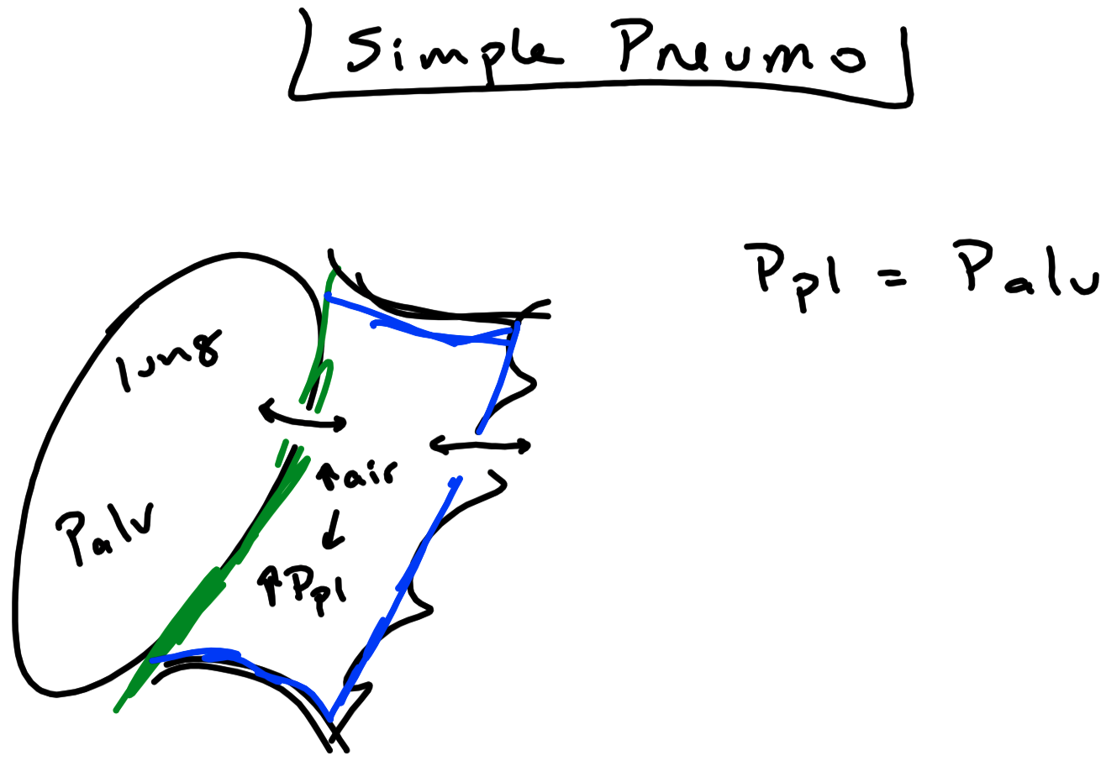

Slide 53
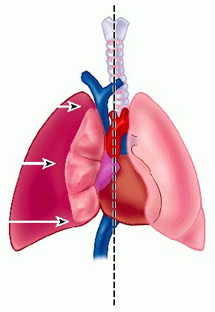
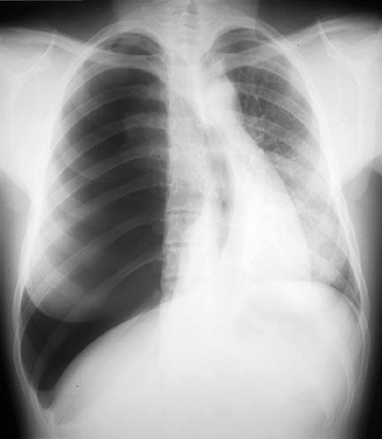
Tension Pneumothorax
Right-sided tension pneumothorax

Slide 54
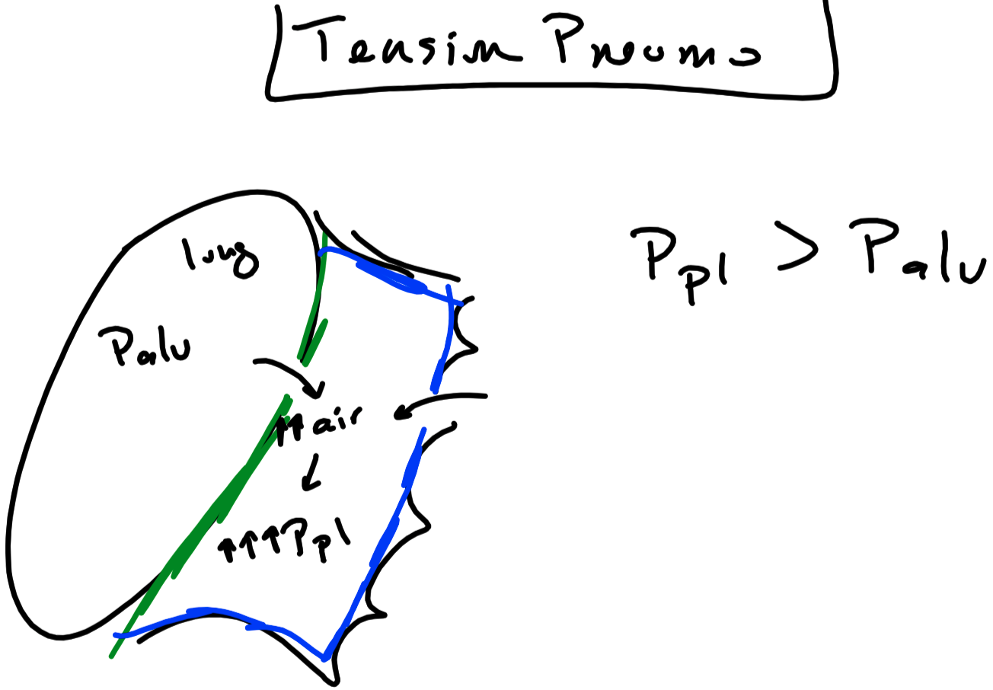

Slide 55
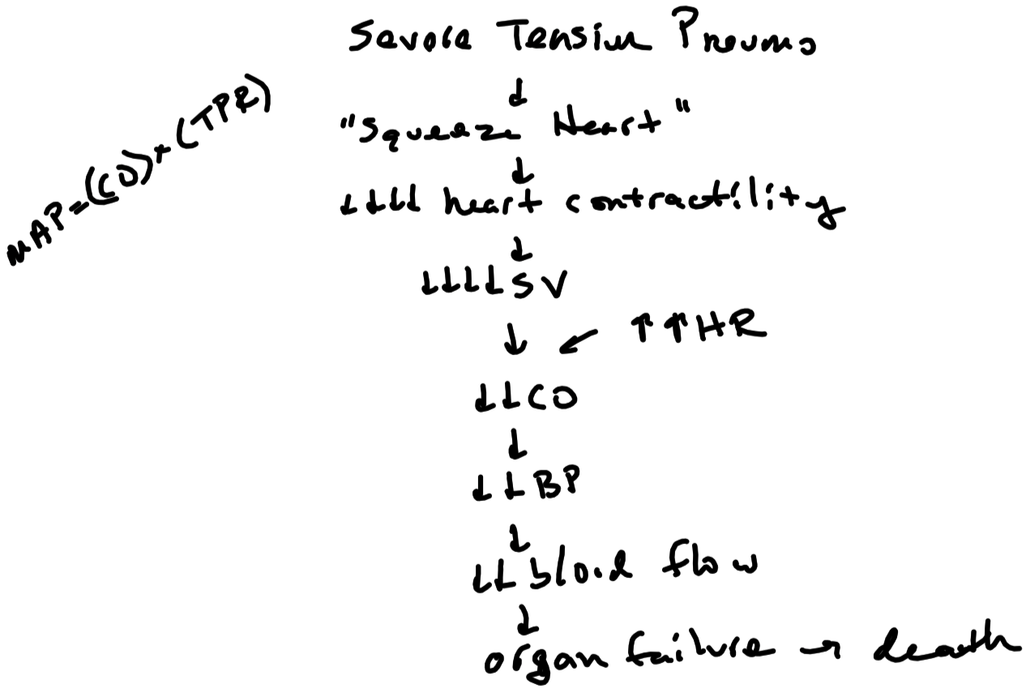

Slide 56
Regulation of Breathing
Respiratory Center
Bilateral network of neurons with pacemaker-like activity in the medulla
Dorsal respiratory group
Innervate and drive the respiratory muscles
Ventral respiratory group
Innervate and drive the respiratory muscles
Contain pacemaker neurons ( pre-Bötzinger complex )
Respiratory center affected by a number of inputs from the body
Cerebrum
Hypothalamus
Pontine respiratory group / Pneumotaxic center
Apneustic center
Chemoreceptors
Pulmonary stretch receptors
Proprioceptors and exteroreceptors

Slide 57
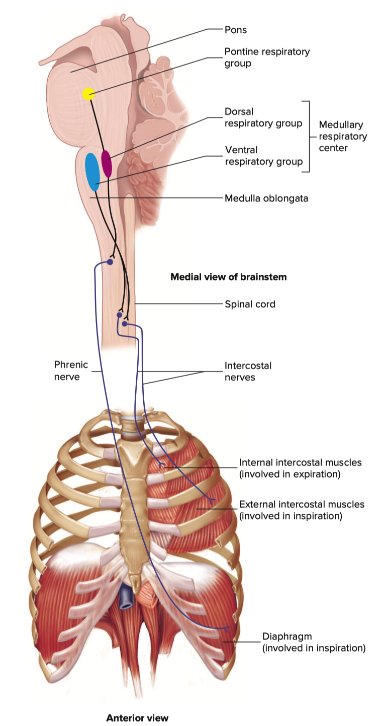
Regulation of Breathing
(Pneumotaxic center)
Apneustic center

Slide 58
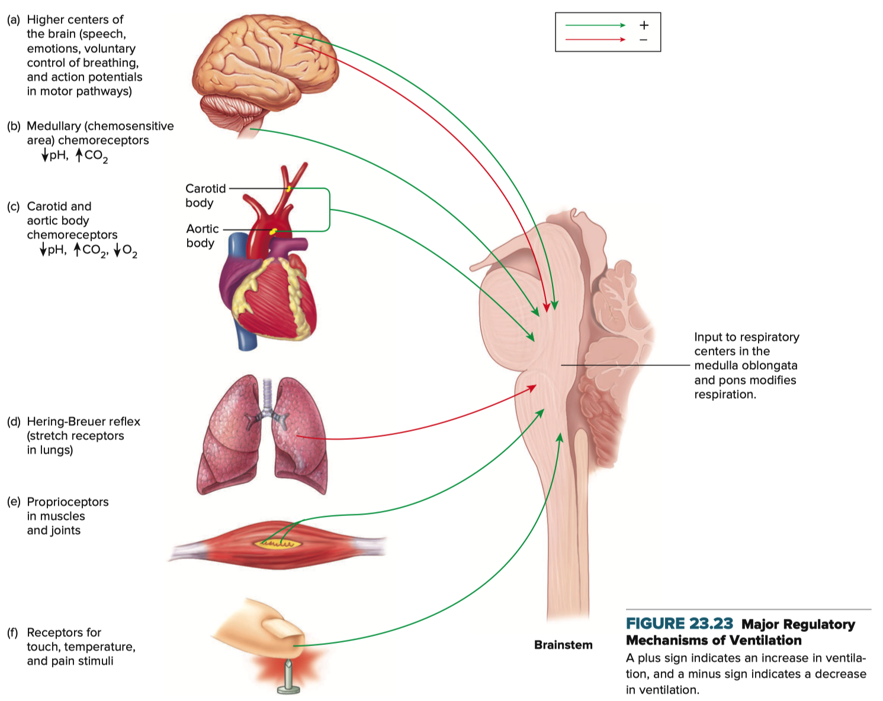
Inputs to Respiratory Centers

Slide 59
Inputs to Respiratory Centers
Cerebrum = voluntary aspect of breathing
Breathing is involuntary but can be voluntarily overridden by the cortex
eg , you can choose to breath faster or hold your breath
Hypothalamus = emotional aspect of breathing
eg , increase ventilation with excitement : decrease ventilation with stress
Pulmonary Irritant Receptors
Located through-out the airways and alveoli
Detect irritants in the lung
Stimulate the respiratory centers to cause coughing

Slide 60
Inputs to Respiratory Centers – Chemoreceptors
Central Chemoreceptors
Neurons located in multiple areas of the medulla and pons
Peripheral Chemoreceptors
Glomus cells located at the bifurcation of the carotid arteries
Monitor arterial CO₂ levels ( mainly central chemoreceptors )
CO₂ is the main stimulus to breathing
Monitor arterial O₂ levels ( mainly peripheral chemoreceptors )
O₂ stimulates breathing only in extreme instances ( PO₂ < 60 mm Hg )

Slide 61
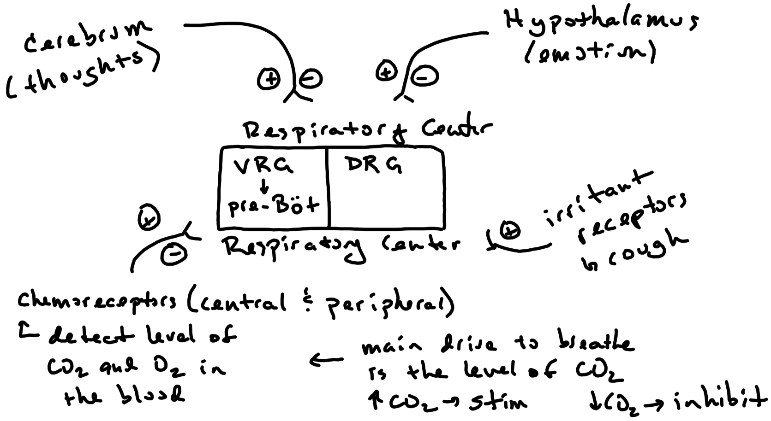

Slide 62
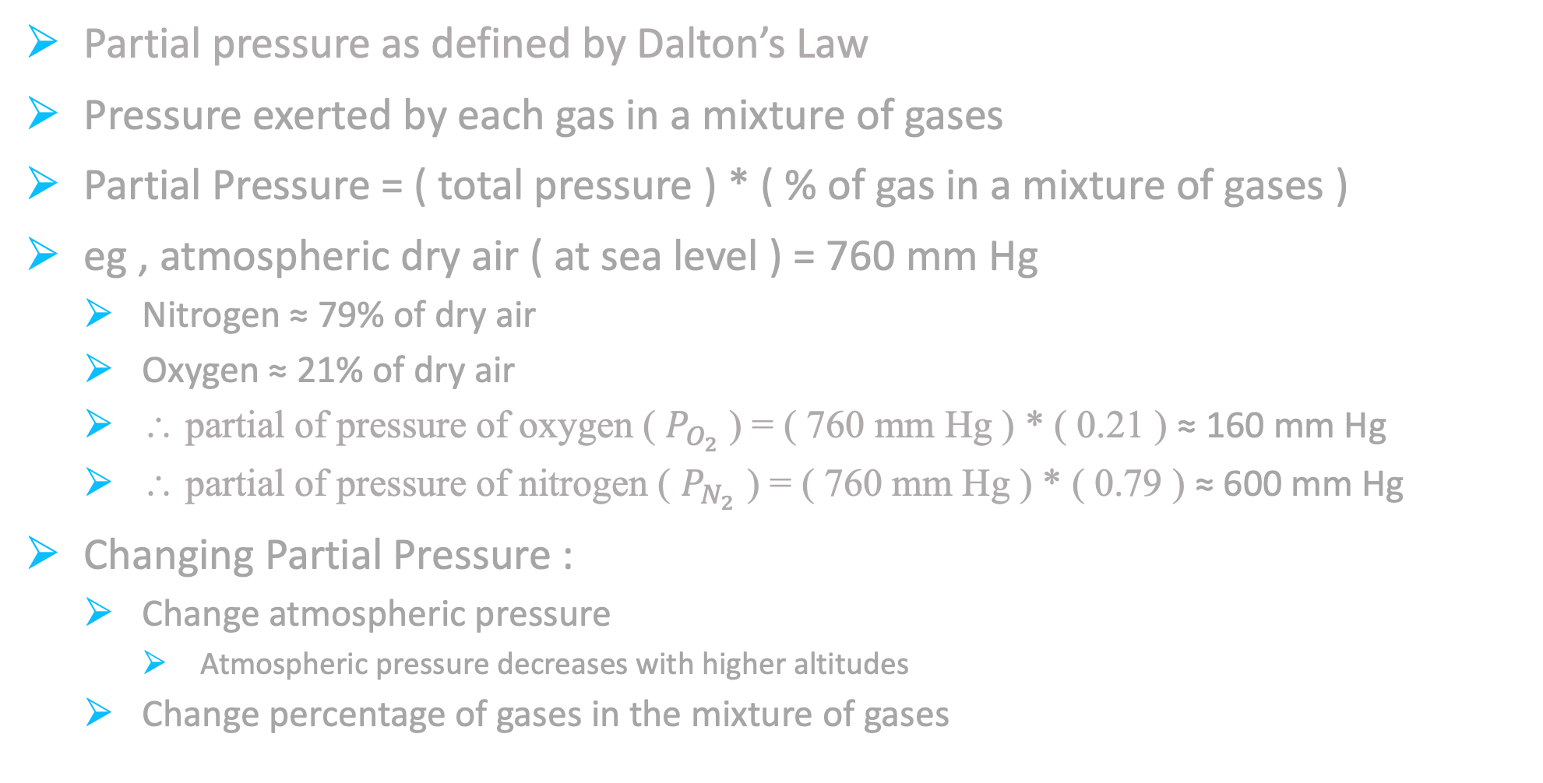
Gas Exchange
Partial pressure as defined by Dalton’s Law
Pressure exerted by each gas in a mixture of gases
Partial Pressure = ( total pressure ) * ( % of gas in a mixture of gases )
eg , atmospheric dry air ( at sea level ) = 760 mm Hg
Nitrogen ≈ 79% of dry air
Oxygen ≈ 21% of dry air
∴ partial of pressure of oxygen ( $P_{O_{2}}$) = ( 760 mm Hg ) * ( 0.21 ) ≈ 160 mm Hg
∴ partial of pressure of nitrogen ( $P_{N_{2}}$ ) = ( 760 mm Hg ) * ( 0.79 ) ≈ 600 mm Hg
Changing Partial Pressure :
Change atmospheric pressure
Atmospheric pressure decreases with higher altitudes
Change percentage of gases in the mixture of gases

Slide 63
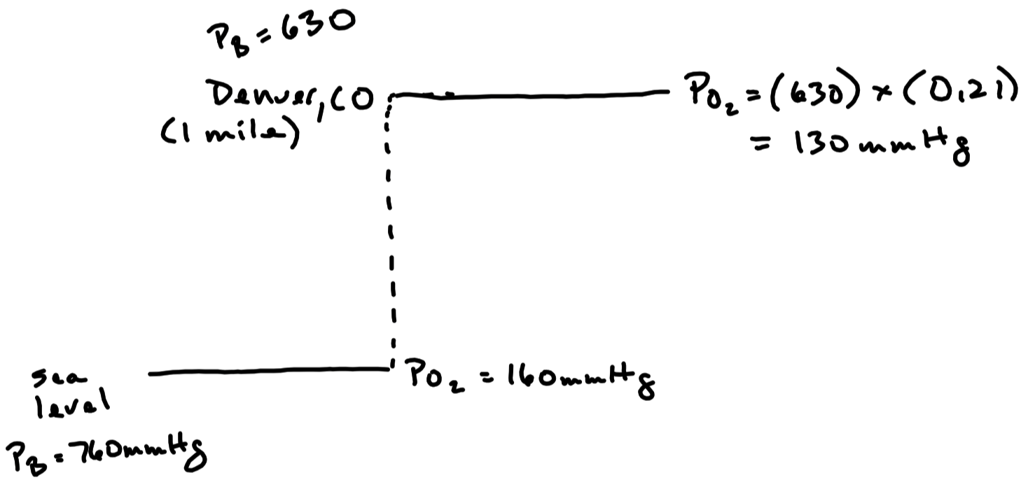

Slide 64
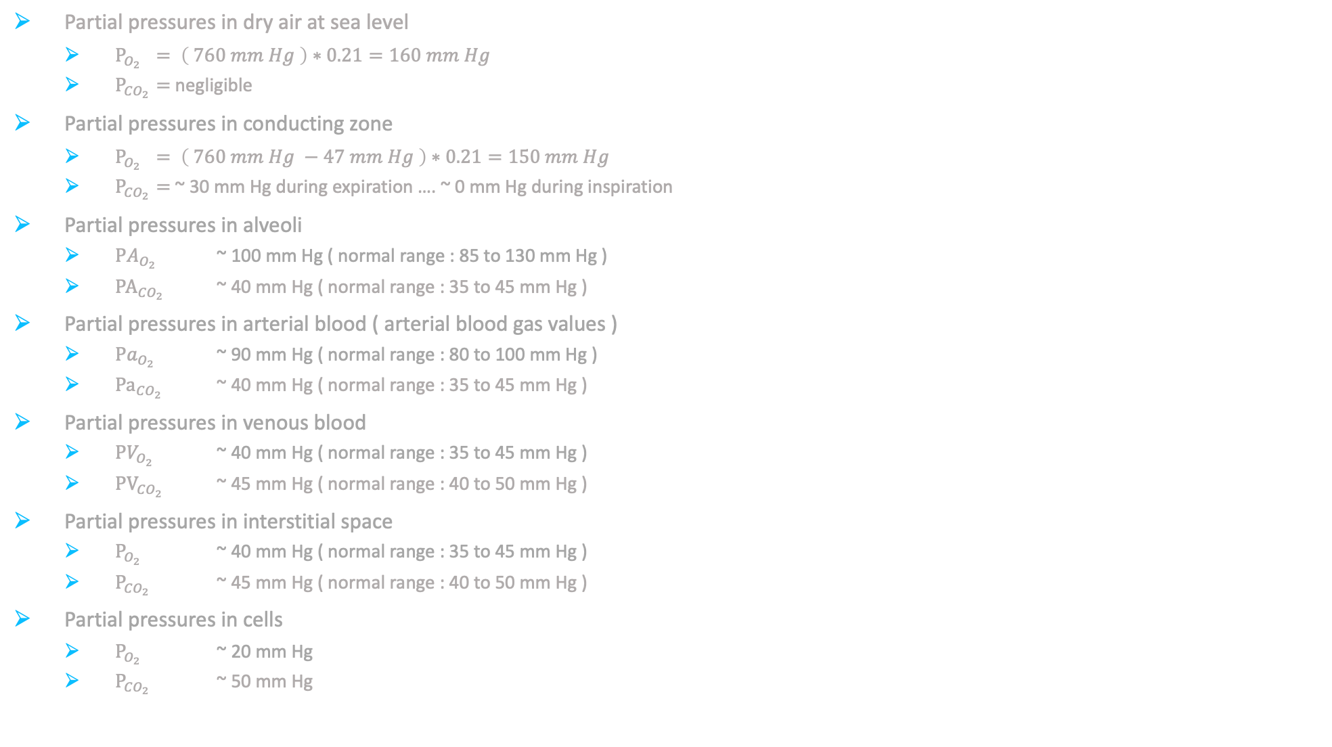
Partial Pressures
Partial pressures in dry air at sea level
$P_{O_{2}} = \left( 760 mm Hg \right)∗0.21=160 mm Hg$
$P_{{CO}_{2}}=$ negligible
Partial pressures in conducting zone
$P_{O_{2}} = \left( 760 mm Hg −47 mm Hg \right)∗0.21=150 mm Hg$
$P_{{CO}_{2}}=$ ~ 30 mm Hg during expiration …. ~ 0 mm Hg during inspiration
Partial pressures in alveoli
${PA}_{O_{2}}$ ~ 100 mm Hg ( normal range : 85 to 130 mm Hg )
${PA}_{{CO}_{2}}$ ~ 40 mm Hg ( normal range : 35 to 45 mm Hg )
Partial pressures in arterial blood ( arterial blood gas values )
${Pa}_{O_{2}}$ ~ 90 mm Hg ( normal range : 80 to 100 mm Hg )
${Pa}_{{CO}_{2}}$ ~ 40 mm Hg ( normal range : 35 to 45 mm Hg )
Partial pressures in venous blood
${PV}_{O_{2}}$ ~ 40 mm Hg ( normal range : 35 to 45 mm Hg )
${PV}_{{CO}_{2}}$ ~ 45 mm Hg ( normal range : 40 to 50 mm Hg )
Partial pressures in interstitial space
$P_{O_{2}}$ ~ 40 mm Hg ( normal range : 35 to 45 mm Hg )
$P_{{CO}_{2}}$ ~ 45 mm Hg ( normal range : 40 to 50 mm Hg )
Partial pressures in cells
$P_{O_{2}}$ ~ 20 mm Hg
$P_{{CO}_{2}}$ ~ 50 mm Hg

Slide 65
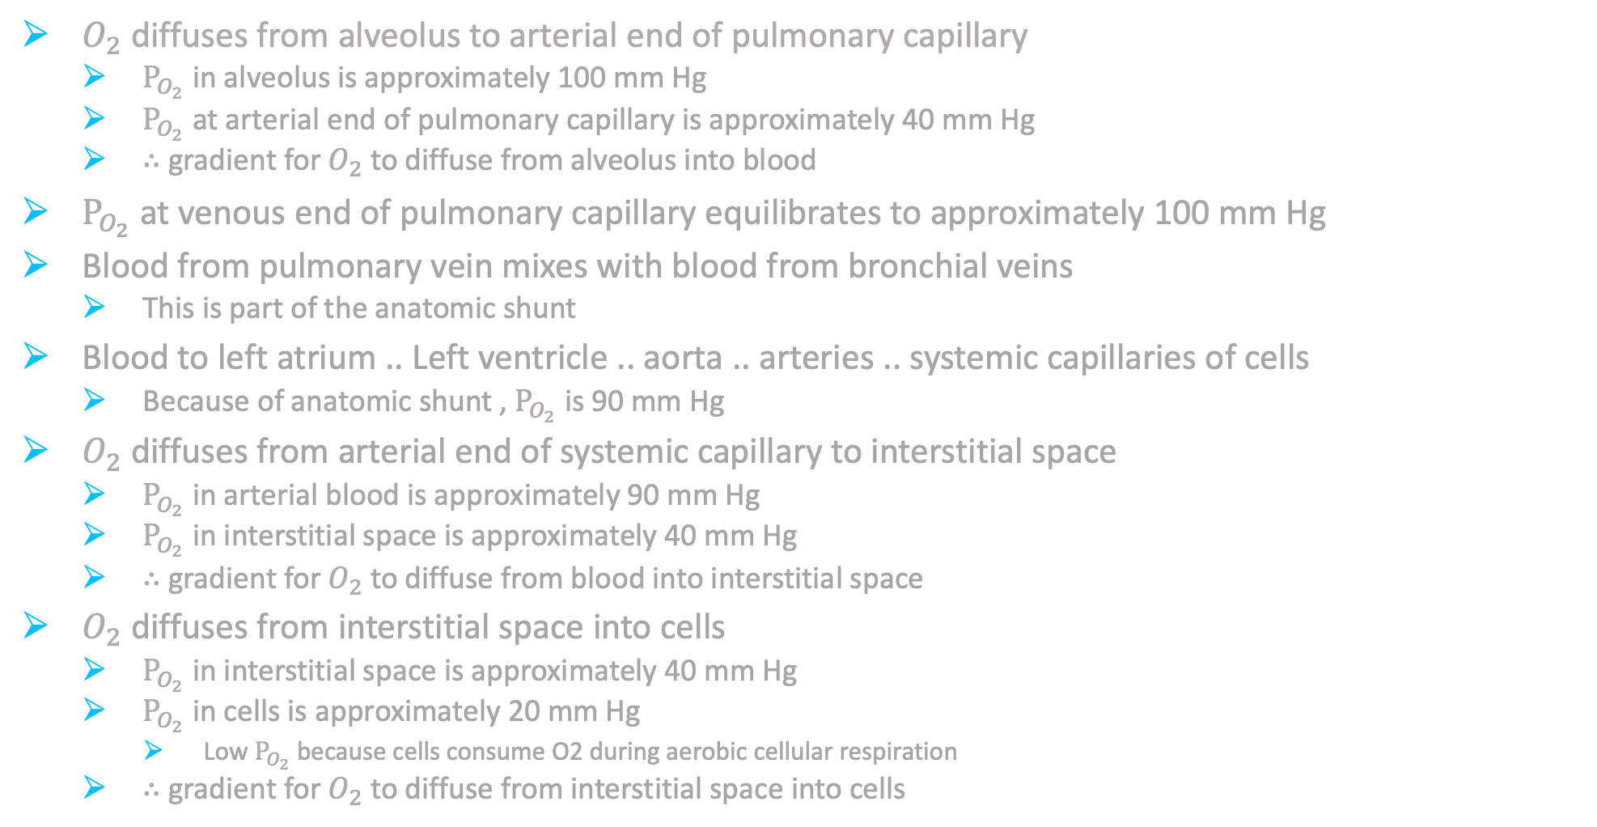
Oxygen Diffusion Gradients
$O_{2}$ diffuses from alveolus to arterial end of pulmonary capillary
$P_{O_{2}}$ in alveolus is approximately 100 mm Hg
$P_{O_{2}}$ at arterial end of pulmonary capillary is approximately 40 mm Hg
$∴$ gradient for $O_{2}$ to diffuse from alveolus into blood
$P_{O_{2}}$ at venous end of pulmonary capillary equilibrates to approximately 100 mm Hg
Blood from pulmonary vein mixes with blood from bronchial veins
This is part of the anatomic shunt
Blood to left atrium .. Left ventricle .. aorta .. arteries .. systemic capillaries of cells
Because of anatomic shunt , $P_{O_{2}}$ is 90 mm Hg
$O_{2}$ diffuses from arterial end of systemic capillary to interstitial space
$P_{O_{2}}$ in arterial blood is approximately 90 mm Hg
$P_{O_{2}}$ in interstitial space is approximately 40 mm Hg
$∴$ gradient for $O_{2}$ to diffuse from blood into interstitial space
$O_{2}$ diffuses from interstitial space into cells
$P_{O_{2}}$ in interstitial space is approximately 40 mm Hg
$P_{O_{2}}$ in cells is approximately 20 mm Hg
Low $P_{O_{2}}$ because cells consume O2 during aerobic cellular respiration
$∴$ gradient for $O_{2}$ to diffuse from interstitial space into cells

Slide 66
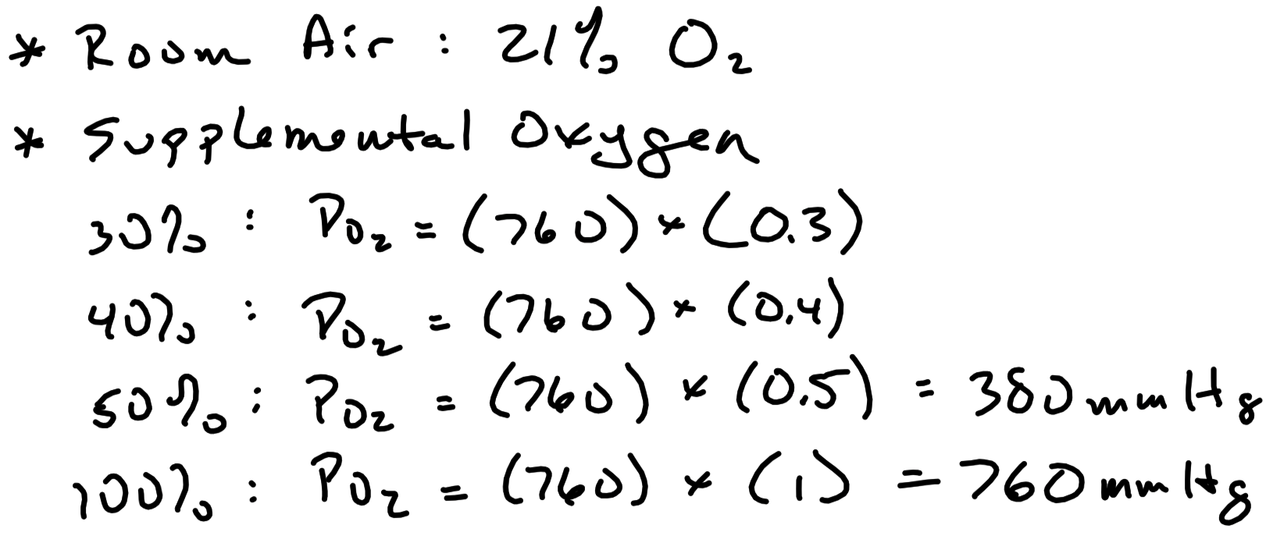

Slide 67
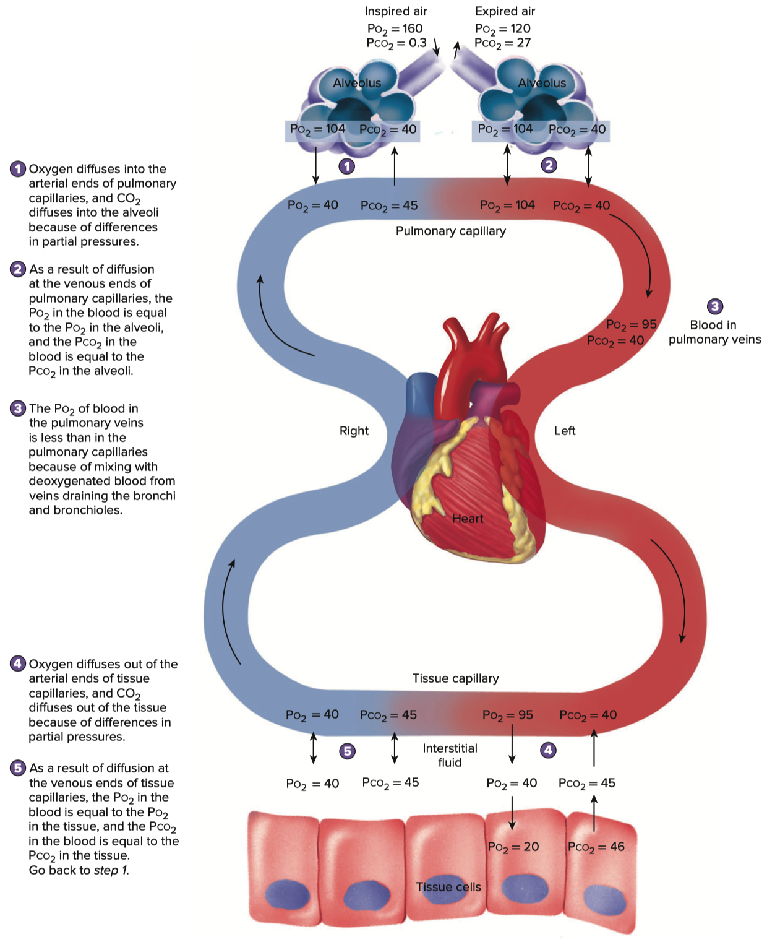

Slide 68
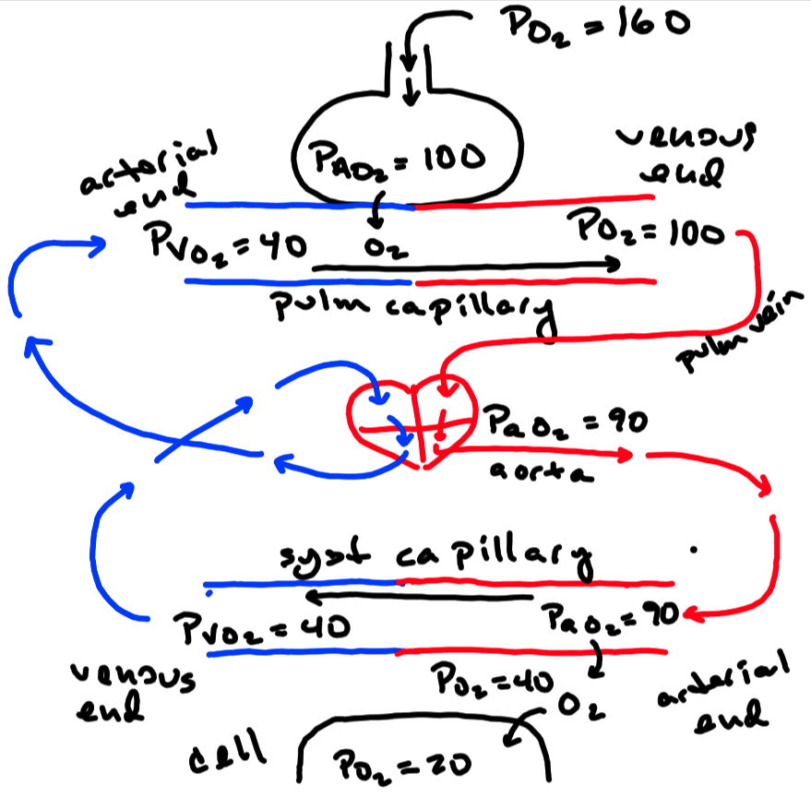

Slide 69


Slide 70


Slide 71

Carbon Dioxide Diffusion Gradients
${CO}_{2}$ diffuses from cells to interstitial space
$P_{CO_{2}}$ in cells is approximately 50 mm Hg
$P_{CO_{2}}$produced in cells during aerobic cellular respiration
$P_{CO_{2}}$ in interstitial space is approximately 45 mm Hg
$∴$ gradient for ${CO}_{2}$ to diffuse from cells to interstitial space
${CO}_{2}$ diffuses from interstitial space to arterial end of systemic capillary
$P_{CO_{2}}$ in interstitial space is approximately 45 mm Hg
$P_{CO_{2}}$ in arterial end of systemic capillary is approximately 40 mm Hg
$∴$ gradient for ${CO}_{2}$ to diffuse from interstitial space to blood
$P_{CO_{2}}$ at venous end of systemic capillary equilibrates to approximately 45 mm Hg
Blood to right atrium … right ventricle … pulmonary artery … pulmonary capillaries
${CO}_{2}$ diffuses from arterial end of pulmonary capillary to alveolus
$P_{CO_{2}}$ at arterial end of pulmonary capillary is approximately 45 mm Hg
$P_{CO_{2}}$ in alveoli is approximately 40 mm Hg
$∴$ gradient for ${CO}_{2}$ to diffuse from blood to alveolus
$P_{CO_{2}}$ equilibrates to approximately 40 mm Hg at venous end of pulmonary capillary

Slide 72


Slide 73
Gas Transport
Oxygen is transported in two different ways :
Dissolved ( ~ 1.5 % )
Hemoglobin ( ~ 98.5 % )
Carbon dioxide is transported in three different ways
Dissolved ( ~ 5 to 30 % )
Hemoglobin ( ~ 5 to 10 % )
Bicarbonate ( ~ 60 to 90 % )

Slide 74

Gas Transport
Oxygen Transport
~ 1.5 % dissolved in the plasma
Low because oxygen is not very soluble in water
Henry’s Law
$\left( Dissolved Gas \right)=\left( P_{gas} \right)∗\left( Solubility Coefficient of that Gas \right)$
Dissolved oxygen is responsible for its partial pressures in body fluids

Slide 75


Gas Transport
Transported by Hemoglobin : ~ 98.5 %
Hemoglobin has the ability to bind up to 4 oxygen molecules
When hemoglobin has 4 oxygen molecules bound , it is fully saturated
$SaO_{2}$ = percent of Hb molecules fully saturated with oxygen
$SaO_{2}$ of arterial blood is measured with a pulse oximeter
Normal pulse ox range = 95 to 100 %
Pulse ox under 90 % is considered abnormal
O₂
O₂
fully
saturated
O₂
O₂

Slide 76


Slide 77


Hemoglobin-Oxygen Binding
As $P_{O_{2}}$ increases , the oxygen bound to Hb increases
Arterial = At a $P_{O_{2}}$ of 90 mm Hg :
$SaO_{2}$ is approximately 100 %
Venous = At a $P_{O_{2}}$ of 40 mm Hg :
$SaO_{2}$ is approximately 75 %

Slide 78
Oxygen–Hemoglobin Binding
Affected By :
CO₂ / pH
Temperature
2,3-biphosphoglycerate
Carbon monoxide

Slide 79

Altering Oxygen–Hemoglobin Binding
Changes in ${CO}_{2}$ / pH
Increase in ${CO}_{2}$ / decrease in pH decreases binding
Decrease in the affinity of Hb for oxygen
Occurs at the body tissues
More oxygen released from Hb
“Right shift” of the oxygen-Hb binding curve
ie , affinity of Hb for $O_{2}$ is decreased
Decrease in ${CO}_{2}$ / increase in pH increases binding
Increase in the affinity of Hb for oxygen
Occurs at the lungs
More oxygen binds to Hb
“Left shift” of the oxygen-Hb binding curve
ie , affinity for Hb for $O_{2}$ is increased
Changes in Temperature
Increase in temperature decreases binding
Occurs at the body tissues
Right shift
Decrease in temperature increases binding
Occurs at the lungs
Left shift

Slide 80

Altering Oxygen–Hemoglobin Binding
Carbon Monoxide ( CO )
CO displaces oxygen from hemoglobin
Hb has 250 times greater affinity for CO
$P_{O_{2}}$ is unchanged
Whatever oxygen is bound , is tightly bound
CO increases affinity of Hb for oxygen
Left shift

Slide 81

Altering Oxygen–Hemoglobin Binding
and with CO
and BPG is produced

Slide 82


Slide 83


Slide 84


Slide 85
Altering Oxygen–Hemoglobin Binding
Decrease the Affinity of Hb for O₂
( i.e. cause a right shift in the O₂ – Hb binding curve )
Increase the Affinity of Hb for O₂
( i.e. cause a left shift in the O₂ – Hb binding curve )
↓ pH
↑ CO₂
↑ temperature
↑ pH
↓ CO₂
↓ temperature
CO

Slide 86

$O_{2}$ Saturation ( $SaO_{2}$ ) , $O_{2}$ Capacity and $O_{2}$ Content
$O_{2}$ saturation ( $SaO_{2}$ ) = percent of Hb fully saturated with oxygen
$O_{2}$ capacity = greatest amount of $O_{2}$ that can be carried in the blood
$O_{2}$ content = amount of $O_{2}$ that is actually carried in the blood

Slide 87


Slide 88

Carbon Dioxide Transport
Transported by hemoglobin : ~ 5% in arterial blood … ~ 10% in venous blood
Carbaminohemoglobin ( CO₂ bound to hemoglobin )
Transported as $HCO_{3}^{−}$ : ~ 90% in arterial blood … ~ 60% in venous blood
$CO_{2}+H_{2}O=HCO_{3}^{−}$ ( “hydration” of CO₂ )

Slide 89


$CO_{2}$ Carried as $HCO_{3}^{−}$

Slide 90
Ventilation (${ \dot{V}}_{A}$ ) / Perfusion ($\dot{Q}$) Relationship
When Upright :
Regional differences in ventilation and perfusion exist ( due to the effects of gravity )
Perfusion and ventilation are both lower at the apex of the lung
Perfusion and ventilation are both higher at the base of the lung
When Supine or Prone :
Even perfusion and ventilation throughout the lung

Slide 91


Slide 92

Pulmonary Ventilation
Minute Ventilation ( ${\dot{V}}_{E}$ ) = volume of air moved into the lungs per minute
${\dot{V}}_{E}=Tidal Volume ∗Respiratory Rate$
$\frac{500 mL}{1 breath} ∗\frac{12 breaths}{1 minute}=\frac{6,000 mL}{1 minute}$
Alveolar Ventilation ( ${\dot{V}}_{A}$ ) = amount of air available for gas exchange per minute
${\dot{V}}_{A}=\left( Tidal Volume −Dead Space \right) ∗Respiratory Rate$
$\frac{500 mL −150 mL}{1 breath} ∗\frac{12 breaths}{1 minute}=\frac{4,200 mL}{1 minute}$
More efficient to increase tidal volume as opposed to respiratory rate

Slide 93

Circulation of the Respiratory System
Perfusion ( $\dot{Q}$ ) of the Lungs
Deoxygenated blood is carried to the lungs via the pulmonary arteries
and then to pulmonary capillaries where blood is oxygenated at the alveoli
Oxygenated blood is then carried back to the heart via the pulmonary veins

Slide 94
Perfusion ( $\dot{Q}$ ) of the lung ( ie , alveoli )
Right Ventricle
Pulmonary Arteries
Pulmonary Capillaries
Pulmonary Veins
Left Atrium
perfusion
of alveoli

Slide 95

Apex
Apex

Slide 96


Slide 97


Slide 98

Ventilation (${ \dot{V}}_{A}$ ) / Perfusion ($\dot{Q}$) Relationship
Level of oxygen in alveoli ( ie , $PA_{O_{2}}$ ) has the greatest effect on perfusion
As $PA_{O_{2}}$ decreases … pulmonary arterioles vasoconstrict , which decreases perfusion
As $PA_{O_{2}}$ increases … pulmonary arterioles vasodilate , which increases perfusion

Slide 99
Pulmonary Disease
Obstructive Pulmonary Disease
Restrictive Pulmonary Disease

Slide 100

Pulmonary Disease – Obstructive
Increase in airway resistance ( airway obstruction )
Air gets trapped in the lungs
Causes an increase in RV and thus an increase in FRC and TLC
Changes in air flow
$FEV_{1}$ and FVC are reduced ($FEV_{1}$ is reduced more )
$∴FEV_{1}$ / FVC is greatly reduced
Ventilation is decreased ( ie , hypoventilation )
Causes hypoxemia
Causes hypercapnia

Slide 101
Pulmonary Disease – Obstructive
Chronic Obstructive Pulmonary Disease ( COPD )
Emphysema
Loss of elastic fibers in walls of bronchioles and alveoli
Increase in compliance
Loss of elastic recoil causes air to be trapped
Causes obstruction to airflow
Chronic Bronchitis
Increased daily mucus production and airway inflammation for at least 3 months in 2 or more consecutive years
Causes airway obstruction
Asthma
Not considered COPD but is caused by obstruction
Bronchoconstriction and inflammation cause airway obstruction

Slide 102


Slide 103

Pulmonary Disease – Restrictive
Great difficulty getting air into the lungs , even though there is no obstruction
All volumes and capacities are reduced
Changes in air flow
Both $FEV_{1}$ and FVC are reduced … but reduced to the same degree
Therefore , $FEV_{1}$ / FVC is normal
Can move air very well ( no obstruction ) but not very much air
Ventilation is decreased ( ie , hypoventilation )
Causes hypoxemia
Causes hypercapnia

Slide 104


Slide 105


Slide 106


Slide 107
Pulmonary Disease – Restrictive
Fibrotic Lung Disease / Interstitial Lung Disease
Lungs become fibrotic
Decrease in compliance
Failure of lungs to expand properly
Lowers ventilation
Fibrosis impairs gas exchange
Causes greater hypoxemia and hypercapnia
Diseases that affect Respiratory Muscles
eg , amyotrophic lateral sclerosis , Guillain Barré , muscular dystrophy
Respiratory muscles unable to contract normally
Cannot produce normal changes in volume
Therefore , cannot cause appropriate changes in pressure
Lowers ventilation

Slide 108


Slide 109
Pulmonary Disease – Restrictive
Surfactant Deficiency Disorder
Most often seen in infants ( called infant respiratory distress syndrome )
Also called hyaline membrane disease
Lack of surfactant production
Decrease in compliance
Alveoli collapse
Lack of ventilation
Acute Respiratory Distress Syndrome ( ARDS )
Diffuse alveolar and pulmonary capillary damage
Leads to fluid build up in alveoli
Decrease in compliance
Impairs gas exchange
Hypoxemia and hypercapnia

Slide 110


Slide 111

Sleep Apnea
Sleep disorder characterized by apneic episodes
At least 5 per hour but can be greater than 100 per hour
Causes oxygen desaturation of approximately 3 to 4 %
Those afflicted are chronically tired
Do not get a restful night of sleep
Over 50% of those afflicted have hypertension
Most likely due to stimulation of sympathetics
Auto resuscitation reflex to breathe
Constant “startling”
Chemoreceptor reflex with increased level of $CO_{2}$
Causes blood pressure to elevate
Type Types :
Central Sleep Apnea
Loss in the drive to breathe
Respiratory network malfunctions
Central chemoreceptors malfunctions
Obstructive Sleep Apnea
Most prevalent type of sleep apnea ( ~ 90% of cases )
Physical obstruction of airways / collapse of airways
However , drive to breathe is present
Tend to snore
More prevalent in heavier individuals
Particularly heaviness at the face and neck

Slide 112
Regulatory Functions of the Urinary System
Regulates contents of blood
Maintains water and electrolyte balance
Maintains osmolarity of blood
Excretes wastes
Regulates blood pressure
Via fluid volume and renin
Regulates production of red blood cells
Erythropoietin
Converts calcidiol into calcitriol ( most biologically active form of vitamin D₃ )

Slide 113
Nephron
Functional unit of the kidney
Approximately one million per kidney
Cortical Nephrons ( 80 % )
Bulk of nephron resides in cortex ( small portion descends into medulla )
Responsible for most regulatory functions
Accomplished via the functional relationship between the renal tubule and peritubular capillary
Juxtamedullary Nephrons ( 20 % )
Descend deep within the medulla
Responsible for regulating osmolarity of the blood
Accomplished via the countercurrent exchanger
Structure made up of the loop of Henle and vasa recta

Slide 114

Nephron

Slide 115

Filtering of Blood
Glomerular Filtration
Filtration of plasma
Glomerulus ➡️ Bowman’s Capsule
Tubular Reabsorption
Selective movement of filtrate
Keeps ion levels in blood normal
renal tubule ➡️ interstitial fluid ➡️ blood
Tubular Secretion
Selective movement of substances
blood to interstitial fluid ➡️ renal tubule
Movement aided by active and passive processes
20% of the plasma gets filtered per 1 run through the glomerulus

Slide 116

Nephron

Slide 117


Slide 118
Glomerular Filtration
Filtration of plasma from glomerulus to Bowman’s capsule
Fluid produced is known as the filtrate
Filtrate is devoid of large substances :
eg , RBCs , WBCs , platelets , protein , lipids
Glomerulonephritis = damage to the glomerulus
Large , otherwise restricted molecules are now filtered
eg , blood cells and / or proteins in urine ( hematuria and / or proteinuria )

Slide 119
Glomerular Filtration Rate ( GFR )
Renal Blood Flow Rate
Volume of blood that flows through the kidneys per minute
Product of the renal fraction ( ~ 20% ) and cardiac output
Renal fraction : percent of cardiac output that flows to kidneys , 20%
Renal blood flow rate = ( ~ 5,000 mL / min ) * 20 % ≈ 1,000 mL / minute
Renal Plasma Flow Rate
Volume of plasma that flows through the kidney per minute
Product of renal blood flow rate and plasma concentration
Plasma concentration is approximately 55 %
Can be calculated by : 100 % minus hematocrit
Renal Plasma Flow = ( 1,000 mL / minute ) * 55 % ≈ 550 mL / minute
Glomerular Filtration Rate ( GFR )
Volume of plasma that is filtered by the glomeruli per minute
Fluid known as filtrate
Product of renal plasma flow and filtration fraction ( ~ 20 % )
Filtration Fraction = percent of plasma that is filtered
GFR = ( 550 mL / min ) * 20 % ≈ 110 mL / minute
Therefore , ~ 110 mL of filtrate is produced per minute
This translates into ~ 160 liters / day , but 99% gets reabsorbed back into blood stream

Slide 120


Slide 121


Slide 122
How to Interpret GFR
Normal GFR :
Above 90 mL / min for most
As low as 60 mL / min is still normal if there is no sign of kidney issues
Abnormal GFR :
Below 60 mL / min = kidney damage
Below 15 mL / min = end stage kidney disease

Slide 123

Efficiency of Glomerular Filtration Rate
Glomerulus is under high hydrostatic pressure
Efferent arteriole is smaller than afferent arteriole
Allows for positive net filtration pressure
Glomerulus is highly coiled
Increases surface area
Glomerulus is highly permeable
Net Filtration Pressure :
Force favoring filtration versus force opposing filtration
Glomerular blood pressure ( favors ) ~ 50 mm Hg
Plasma colloid osmotic pressure ( opposes ) ~ 30 mm Hg
Bowman’s capsule hydrostatic pressure ( opposes ) ~ 10 mm Hg
∴ net filtration pressure = $50 mm Hg – \left( 30 mm Hg+10 mm Hg \right)=10 mm Hg$
∴ 10 mm Hg force that favors filtration
Filtration occurs if positive , net pressure

Slide 124


Slide 125


Slide 126


Slide 127

Net Filtration Pressure
Efferent
arteriole
Afferent
arteriole

Slide 128


Slide 129
Autoregulation of Glomerular Filtration
Attempts to maintain a constant GFR
If GFR is too high , the kidneys are working too hard
If GFR is too low , the kidneys are not filtering plasma properly
Involves changes in the degree of constriction of the afferent arteriole
In response to changes in blood pressure and filtrate flow
Constant GFR is maintained with blood pressure of 90 to 180 mm Hg

Slide 130
Autoregulation of Glomerular Filtration
With an increase in systemic blood pressure :
This should cause an increase in GFR , but it does not … Why?
Causes constriction of afferent arteriole to keep GFR constant
Maintains a normal glomerular blood pressure
Helps maintain a constant GFR
Maintains a normal renal plasma flow
Helps maintain a constant GFR
With a decrease in systemic blood pressure :
This should cause a decrease in GFR , but it does not … Why?
Causes dilation of afferent arteriole to keep GFR constant
Maintains a normal glomerular blood pressure
Helps maintain a constant GFR
Maintains a normal renal plasma flow
Helps maintain a constant GFR

Slide 131


Slide 132


Slide 133
Tubular Reabsorption
99 % of filtrate is reabsorbed
Movement of water and solutes from renal tubule into peritubular capillaries
Reabsorption is enhanced in the peritubular capillaries
Peritubular capillaries are very permeable
Highly selective
Increased reabsorption of molecule “X” causes an increase in blood [ X ]
Decreased reabsorption of molecule “X” causes a decrease in blood [ X ]

Slide 134
Tubular Reabsorption
Proximal convoluted tubule
Na⁺, Cl⁻ , K⁺ , Ca²⁺ , Mg²⁺ , HCO₃⁻ , PO₄³⁻ , amino acids , glucose , water
Water follows solutes osmotically
Loop of Henle
Thin Segments
Descending Limb
Highly permeable to water
Ascending Limb
Impermeable to water
Thick Ascending Limb
Na⁺ , Cl⁻ , K⁺ , Ca²⁺ , Mg²⁺ , HCO₃⁻
Impermeable to water
Distal convoluted tubule
Na⁺ , Cl⁻ , K⁺ , Ca²⁺ , Mg²⁺ , water ( follows solutes osmotically )
Collecting duct
Na⁺ , Cl⁻ , HCO₃⁻ , K⁺ , urea , Ca²⁺ , water ( follows solutes osmotically )

Slide 135


Slide 136


Slide 137

Reabsorption
Na⁺, Cl⁻, K⁺, Ca²⁺,
Mg²⁺, water
Na⁺, Cl⁻, K⁺, HCO₃⁻,
PO₄³⁻, Ca²⁺, Mg²⁺,
amino acids,
glucose, water
Na⁺, Cl⁻, K⁺, HCO₃⁻,
Ca²⁺, Mg²⁺
water
Na⁺, Cl⁻, HCO₃⁻, K⁺,
urea, Ca²⁺, water

Slide 138
Tubular Secretion
Substances secreted into renal tubule from peritubular capillaries
Mechanisms same as tubular reabsorption but in reverse direction
Increased secretion of molecule “X” causes a decrease in blood [ X ]
Decreased secretion of molecule “X” causes an increase in blood [ X ]
Proximal Convoluted Tubule :
Organic ion transport
Cotransports organic acids with Na⁺
eg , uric acid , bile acids , antibiotics , creatinine , “drugs”
H⁺ , NH₃ ( ammonia )
Distal Convoluted Tubule :
H⁺ , K⁺ , NH₃ ( majority of NH₃ secretion )
Collecting Duct :
H⁺ , K⁺ , NH₃ , urea

Slide 139
Secretion
H⁺, K⁺, NH₃
Organic ions,
H⁺, NH₃
H⁺, K⁺, NH₃, urea

Slide 140


Slide 141


Slide 142


Slide 143
Clearance to Estimate GFR
Need a substance that is :
Freely filtered
Not reabsorbed
Not secreted
Creatinine closely meets the above criteria
Produced naturally in the body as a waste product of the phosphagen system
Used routinely to calculate GFR

Slide 144


Slide 145
Clearance to Estimate Renal Plasma Flow
Need a substance that is :
Freely filtered
Not reabsorbed
Completely secreted
Para-aminohippurate ( PAH ) comes close to meeting the above criteria

Slide 146


Slide 147


Slide 148


Slide 149


Slide 150
Summary of Clearance
If clearance equals GFR :
Substance is completely filtered and not reabsorbed and not secreted
If clearance is zero :
Substance has been fully reabsorbed and not secreted
OR
not filtered and not secreted and not reabsorbed

Slide 151
If Clearance Equals GFR
Substance is completely filtered and not reabsorbed and not secreted
Clearance of inulin ( clinically , clearance of creatine used to estimate GFR )
however, creatinine is secreted
X
X

Slide 152
If Clearance is Zero
Substance has been fully reabsorbed and NOT secreted
or
Substance has been not filtered and not secreted and not reabsorbed
X
X
X
X
eg , glucose
eg , protein

Slide 153

Countercurrent Exchanger
Anatomic relationship between juxtamedullary nephron loop of Henle and the vasta recta
Creates a very large osmotic gradient within the medulla
Osmolarity at the cortex-medulla junction is ~ 300 mOsM
Osmolarity progressively increases to ~ 1,200 mOsM deep within the medulla
Large osmotic gradient is used to regulate blood osmolarity

Slide 154
Factors Involved in Countercurrent Exchange
Thin descending limb of the loop of Henle
Permeable to water
Transport of water ( ie , osmosis ) out of limb
Progressively concentrates filtrate from 300 mOsM to 1,200 mOsM as it descends into the medulla
Some of the water is reabsorbed by the vasa recta
Progressively dilutes blood from 1,200 mOsM to 300 mOsM as it ascends towards the cortex
Helps maintain osmotic gradient of medullary interstitial fluid
Thin and thick ascending limbs of the loop of Henle
Impermeable to water
Permeable to Na⁺ , Cl⁻ ( transport of Na⁺ and Cl⁻ out of limbs )
Progressively concentrates medulla to 1,200 mOsM
Progressively dilutes the filtrate back towards 300 mOsM as it ascends towards the cortex
Na⁺ and Cl⁻ reabsorbed by the vasa recta
Progressively concentrates the blood towards 1,200 mOsM as it descends into the medulla
Helps maintain osmotic gradient within the medulla

Slide 155
Factors Involved in Countercurrent Exchange
Distal convolute tubule dilutes filtrate to 100 mOsM
Transport of Na⁺ and Cl⁻ out of tubule
∴ filtrate entering collecting duct has osmolarity of 100 mOsM

Slide 156


Factors Involved in Countercurrent Exchange

Slide 157
Factors Involved in Countercurrent Exchange
Contribution of urea to the osmotic gradient within the medulla
Transport of urea out of the collecting duct to the medullary interstitial fluid
Aids in concentrating the medullary fluid
Urea is then secreted by the descending limb of the loop of Henle
Aids in concentrating the filtrate
Re-circulates to the collecting duct

Slide 158
Factors Involved in Countercurrent Exchange

Slide 159
Regulation of Blood Osmolarity via ADH
ADH increases permeability of water at distal convoluted tubule and collecting duct.
Stimulates the incorporation of aquaporins ( ie , water channels )
Increases water reabsorption at distal convoluted tubule and collecting duct
Osmosis driven by the osmotic gradient within the medulla
Increased level of ADH released when blood osmolarity is high
Causes more water to be reabsorbed
Thus decreases blood osmolarity towards normal
Urine consequently has a higher osmolarity
Decreased level of ADH released when blood osmolarity is low
Causes less water to be reabsorbed
Thus increases blood osmolarity toward normal
Urine consequently has a lower osmolarity

Slide 160


Slide 161


Slide 162


Slide 163


Slide 164


Slide 165

Regulation of Blood Osmolarity

Slide 166
Diuretics
Drugs that cause excretion of water
Used to treat , for example , edema and hypertension
Loop Diuretics ( eg , Lasix )
Most powerful of the diuretics
Work in ascending limbs of the loop of Henle
Decrease blood K⁺
Thiazides ( eg , Metolazone )
Work mainly in distal convoluted tubule
Decrease blood K⁺
Aldosterone Antagonists ( eg , Inspra )
Work mainly in distal convoluted tubule
Does NOT decrease blood K⁺
∴ potassium sparing

Slide 167


Slide 168
Urine
Approximately 1.5 to 2 liters per day
96 % water
2.5 % nitrogenous wastes ( eg , ammonia , urea , uric acid , creatinine )
1.5 % salts and traces of other substances
pH : 4.6 to 8.0
Osmolarity of between 300 and 900 mOsM
Can be as low as 100 and as high as 1,200 mOsM
Specific Gravity = a weight of a solution compared to that of an equal volume of distilled water
Determined by two things :
osmolarity of urine
Size of particles in urine
Normally between 1.010 and 1.030
Higher value indicates more and / or larger particles in urine
Lower value indicates less and / or smaller particles in urine
Healthy urine is sterile

Slide 169


Slide 170
Micturition / Urination
Anuria = no urine output
Urinary Retention = urine is produced but is not voided
Due to severe obstruction that completely prevents flow of urine ( eg , tumor )
Urinary Suppression = urine is not produced by the kidneys
Renal disease
Oliguria = decreased urine output
eg , dehydration
eg , obstruction ( eg , kidney stone , small tumor )
eg , renal disease
Polyuria = excess urine output
eg , over-hydration
eg , diabetes insipidus ( low ADH ) = dilute urine due to excess water secretion
eg , diabetes mellitus = concentrated urine due to excess glucose in urine
Patients drink lots of water because they feel thirsty
Thirst due to increased blood osmolarity
Dysuria = urine expelled painfully
eg , obstruction ( eg , kidney stone , small tumor )
eg , urinary tract or bladder infection
eg , venereal disease

Slide 171


